Slide 1
Integrative Case Study: Non-coding Variant Interpretation
Session 6
T6: Making the most of cis-regulatory annotations for genome-scale analysis
Gabriela A. Merino
Senior Bioinformatician, Ensembl Regulation, EMBL-EBI
03/09/2026

Slide 2
Hands-on

Slide 3
Case study 1: Human disease locus MYC / 8q24
The 8q24 cancer risk variants rs6983267 and rs67491583 show long-range interaction with MYC in colorectal cancer ^{1,2}.
MYC is one of the most important oncogenes in cancer³:
It is activated in the vast majority of cancers by genetic, epigenetic or post-translational mechanisms.
Its activation drives cancer progression through mechanisms involving either the cell-intrinsic acquisition of hallmarks of cancer or dysregulation of the tumour microenvironment and host immune responses.
Currently, no direct inhibitors of MYC are approved; however, many therapeutic agents targeting MYC are under development.
¹Pomerantz, Mark M et al. “The 8q24 cancer risk variant rs6983267 shows long-range interaction with MYC in colorectal cancer.” Nature genetics vol. 41,8 (2009): 882-4. doi:10.1038/ng.403
²Tuupanen, Sari et al. “Characterization of the colorectal cancer-associated enhancer MYC-335 at 8q24: the role of rs67491583.” Cancer genetics vol. 205,1-2 (2012): 25-33. doi:10.1016/j.cancergen.2012.01.005
³Dhanasekaran, Renumathy et al. “The MYC oncogene — the grand orchestrator of cancer growth and immune evasion.” Nature Reviews Clinical Oncology vol. 19, 23–36 (2022). doi:10.1038/s41571-021-00549-2

Slide 4
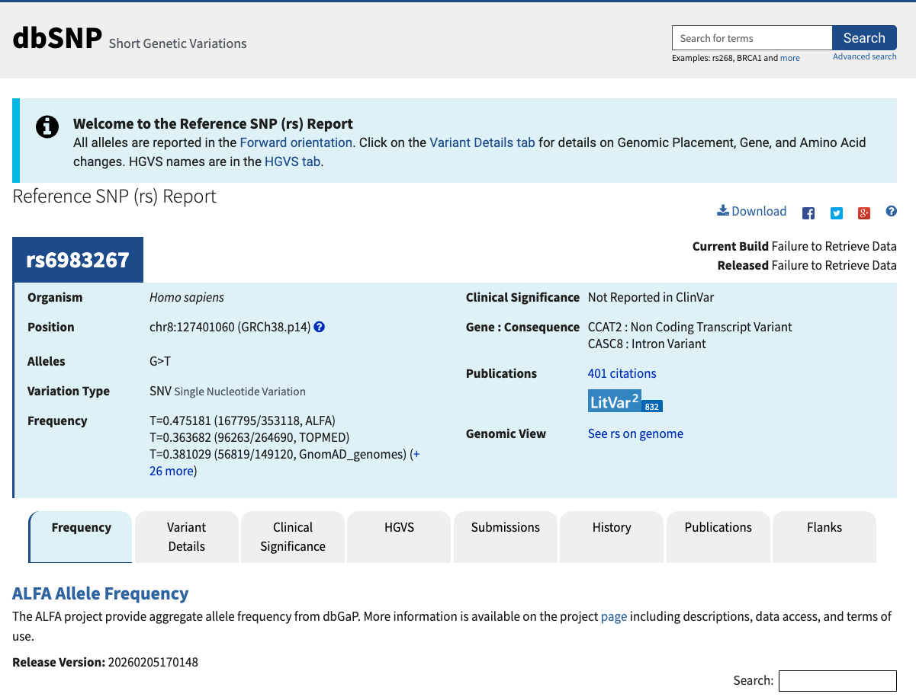
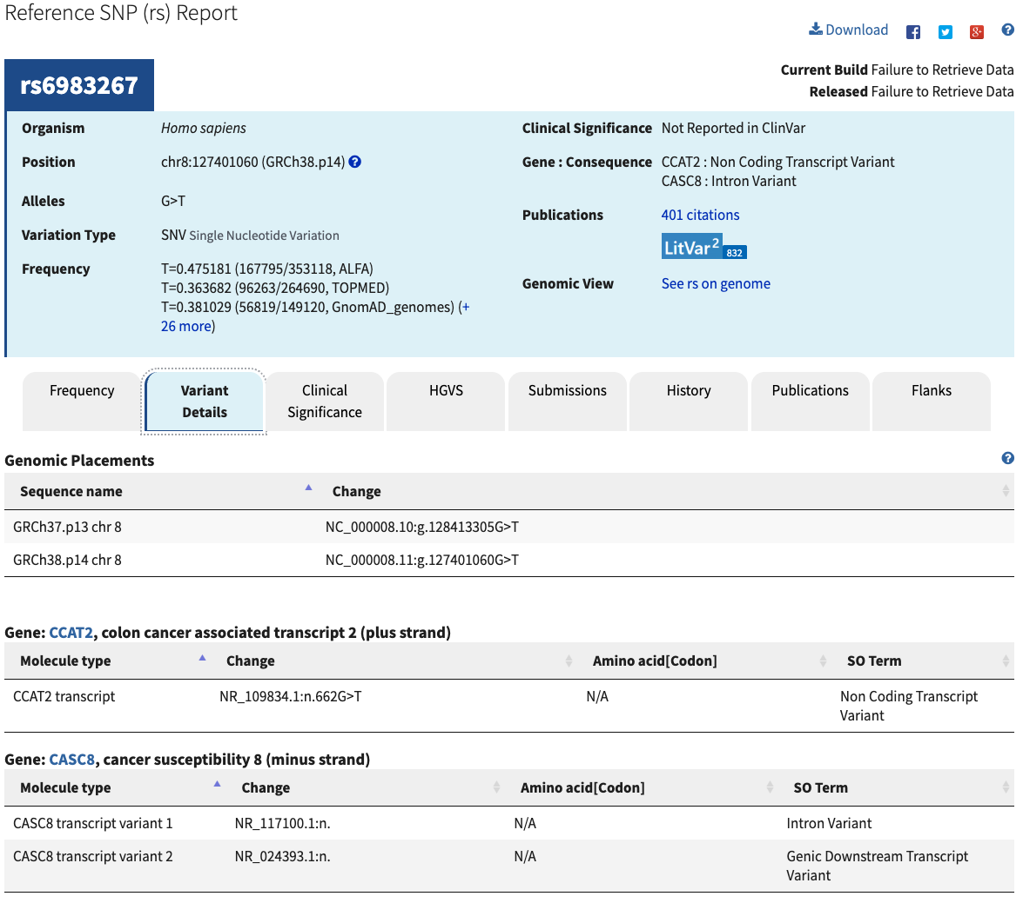
Case study 1: Human disease locus MYC / 8q24

Slide 5
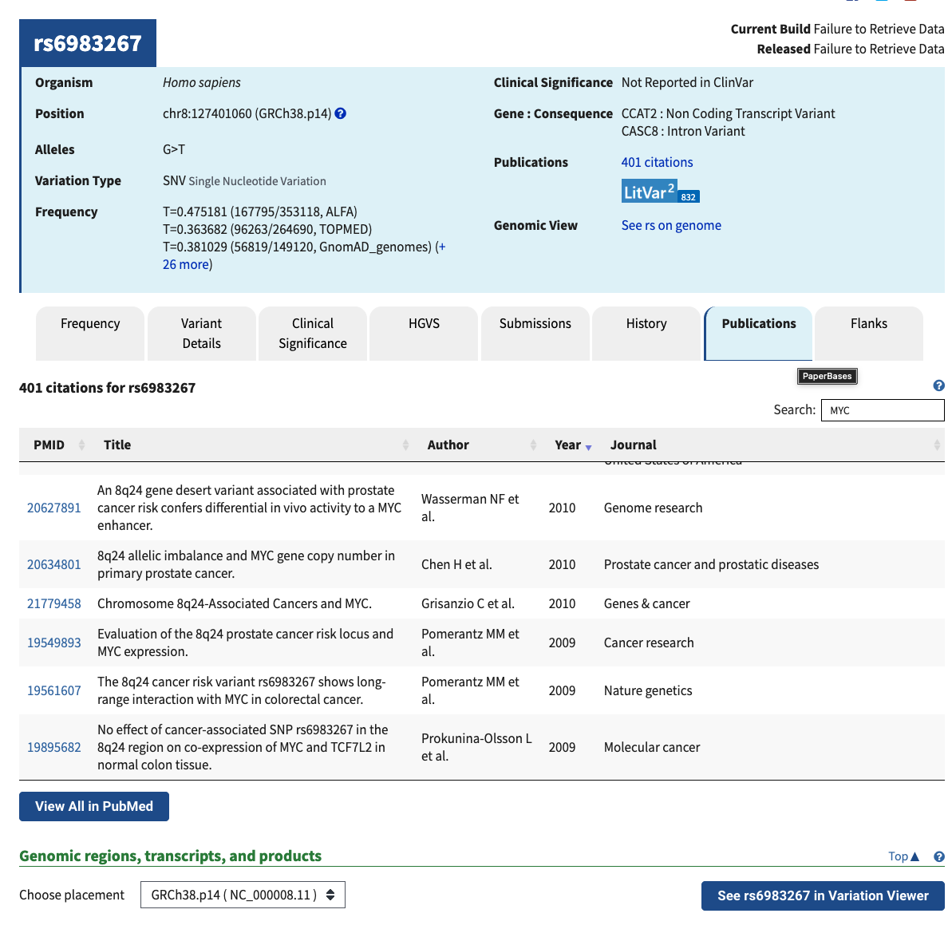
Case study 1: Human disease locus MYC / 8q24

Slide 6
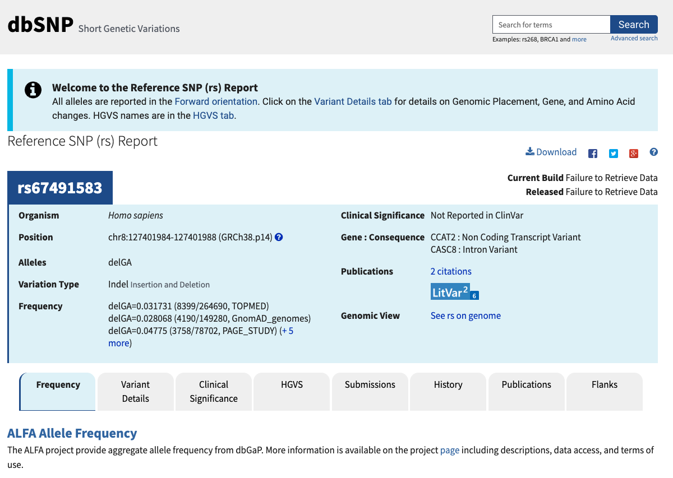
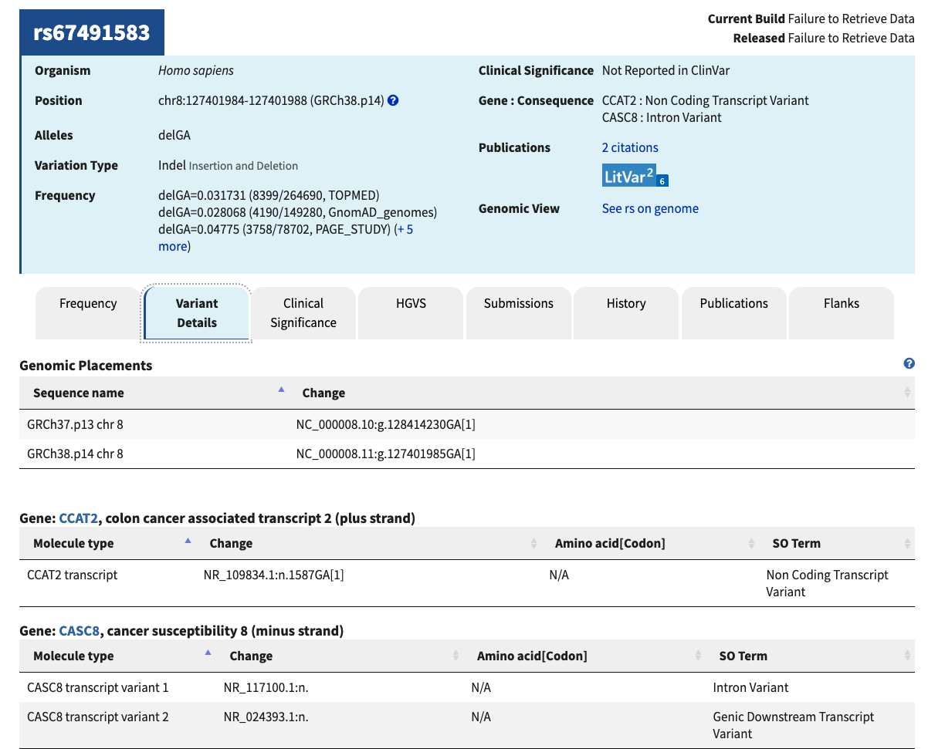
Case study 1: Human disease locus MYC / 8q24

Slide 7
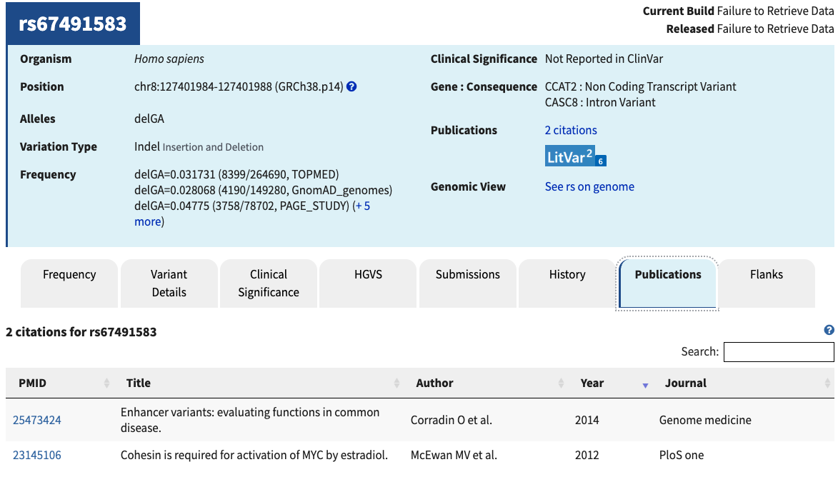
Case study 1: Human disease locus MYC / 8q24

Slide 8
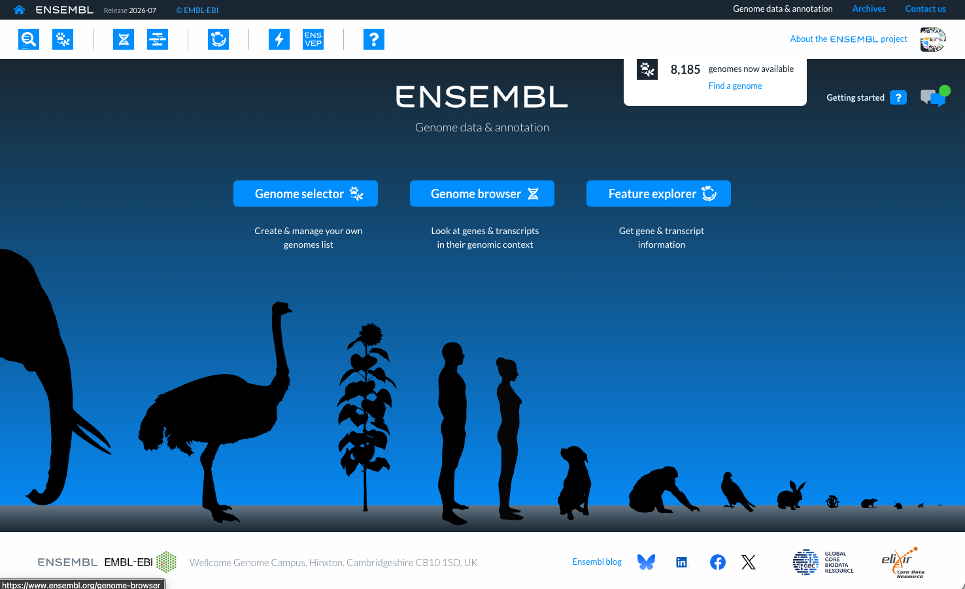
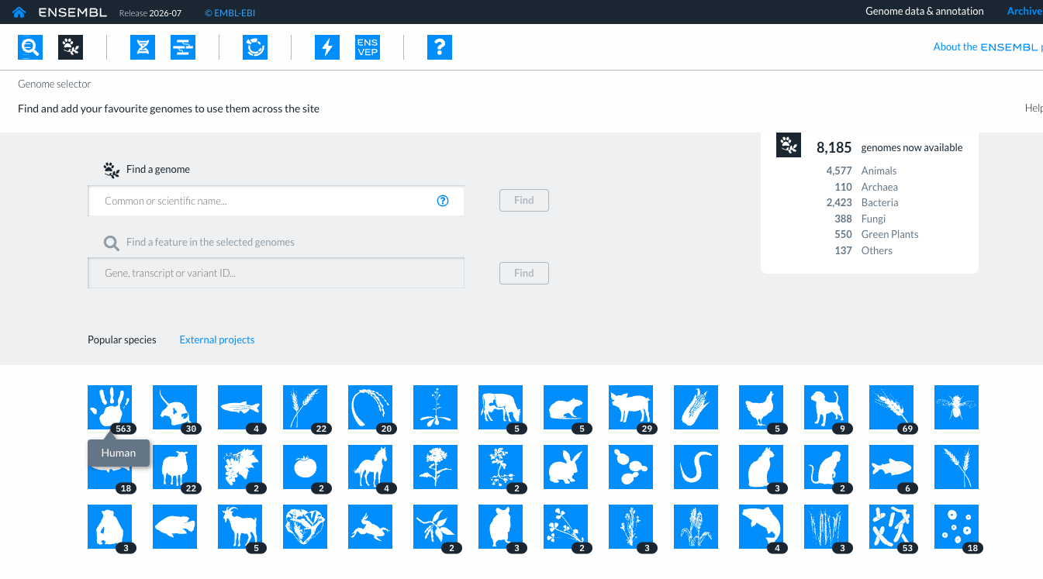
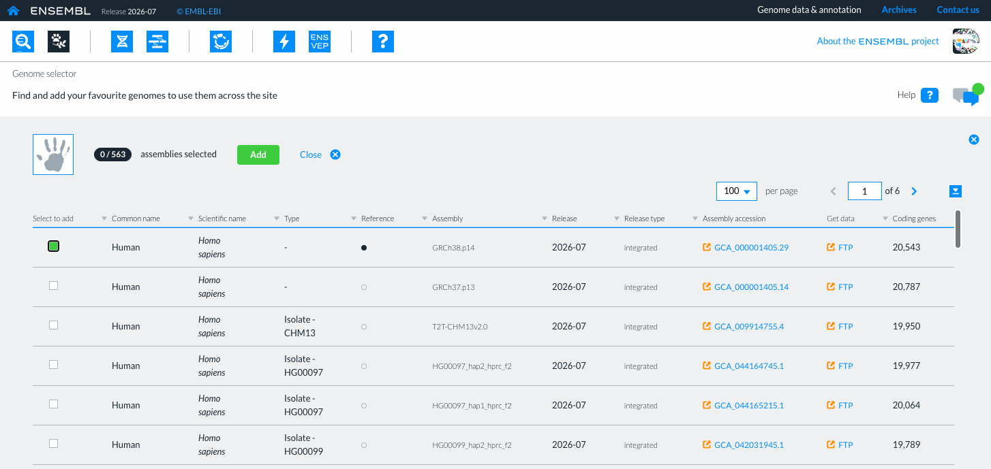
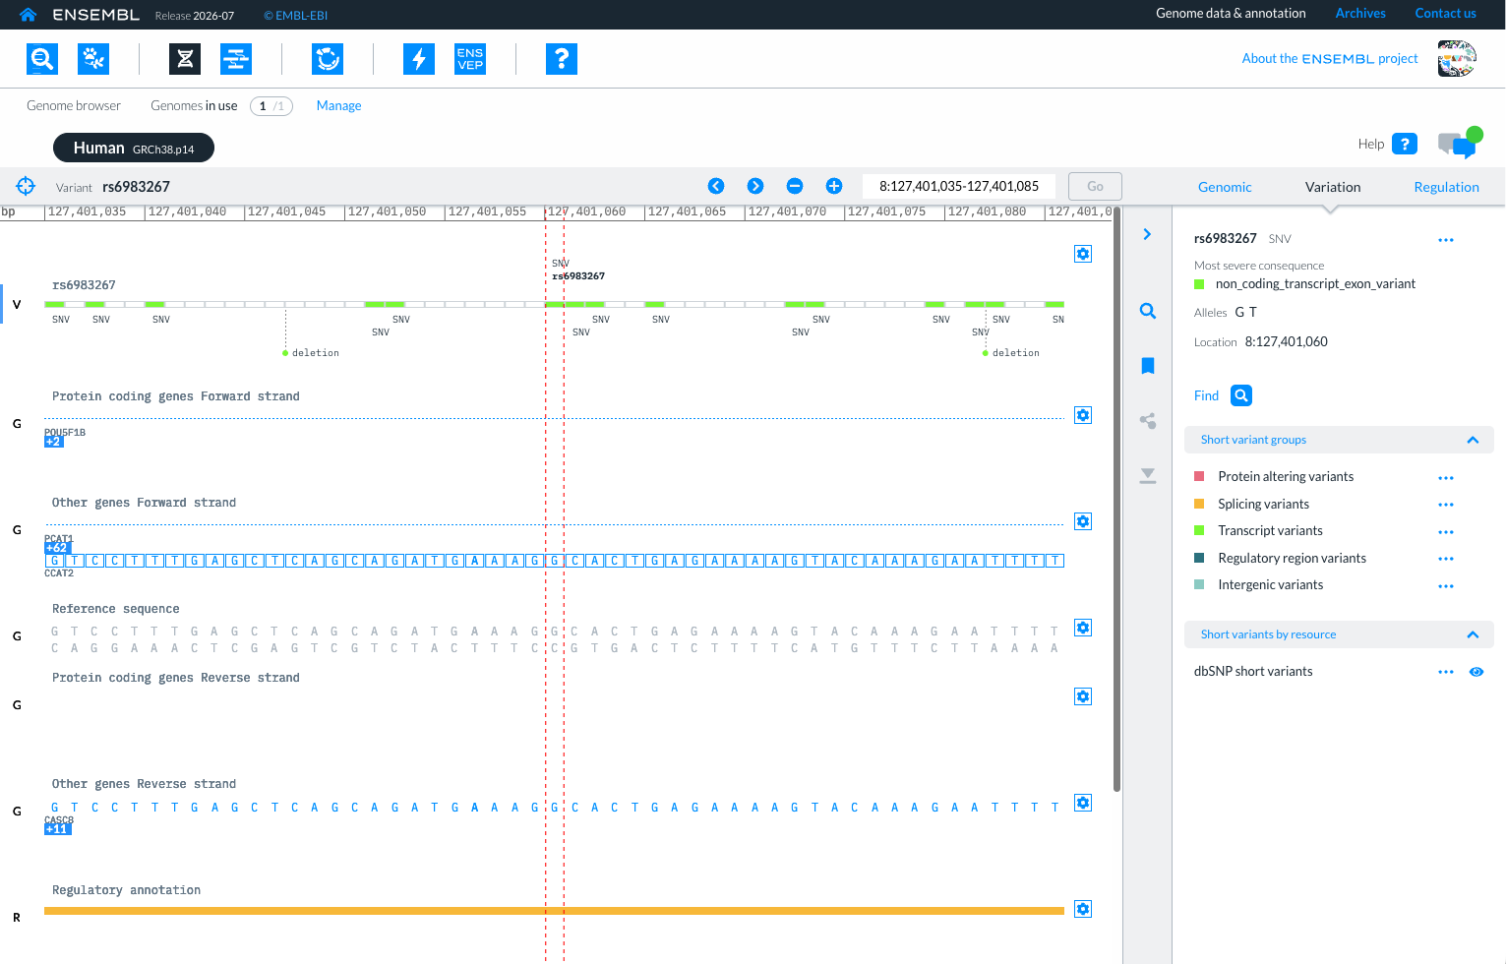
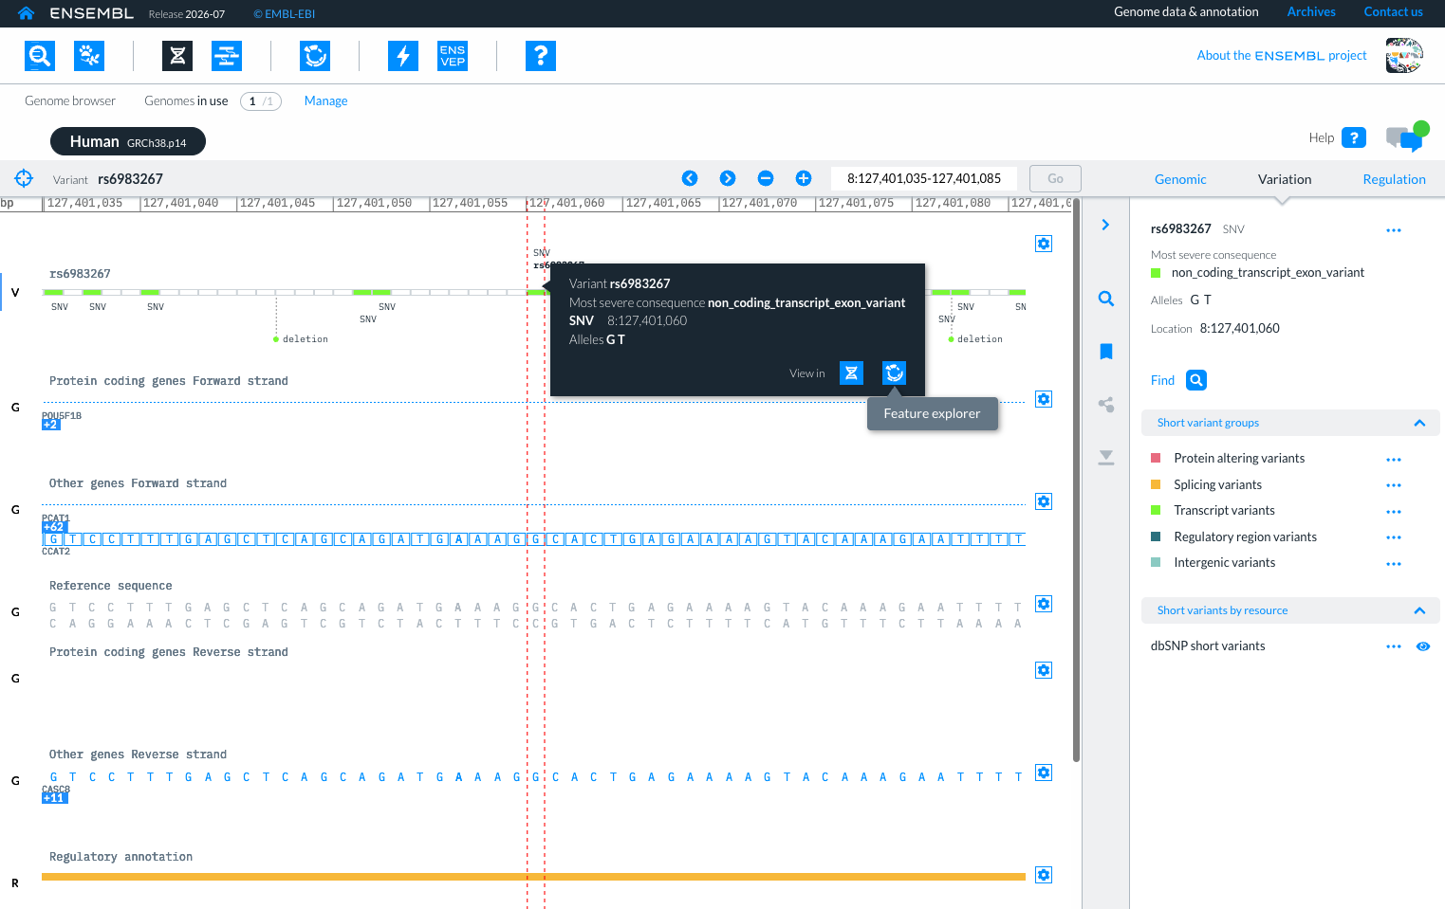
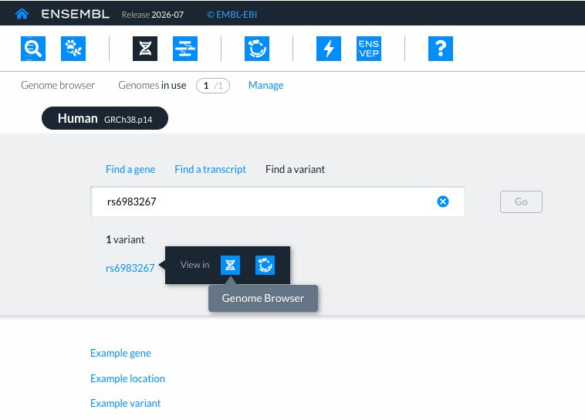
Case study 1: Human disease locus MYC / 8q24

Slide 9
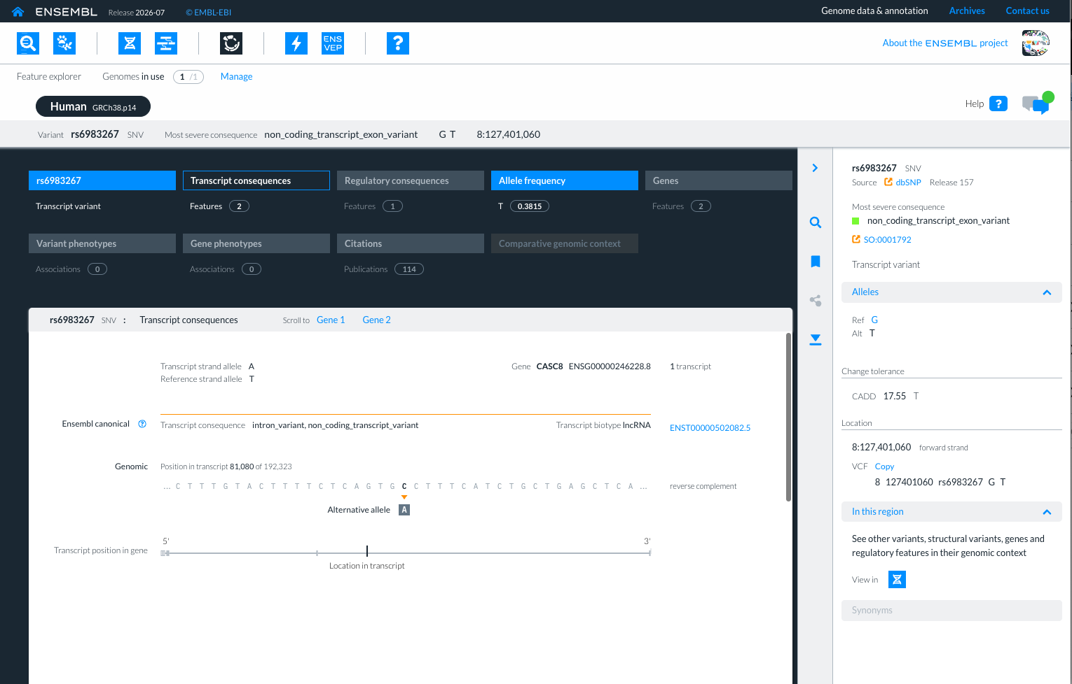
Case study 1: Human disease locus MYC / 8q24

Slide 10
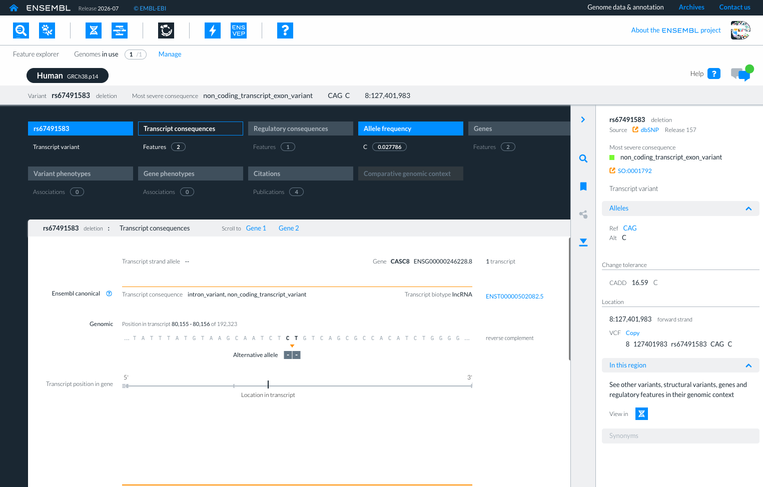
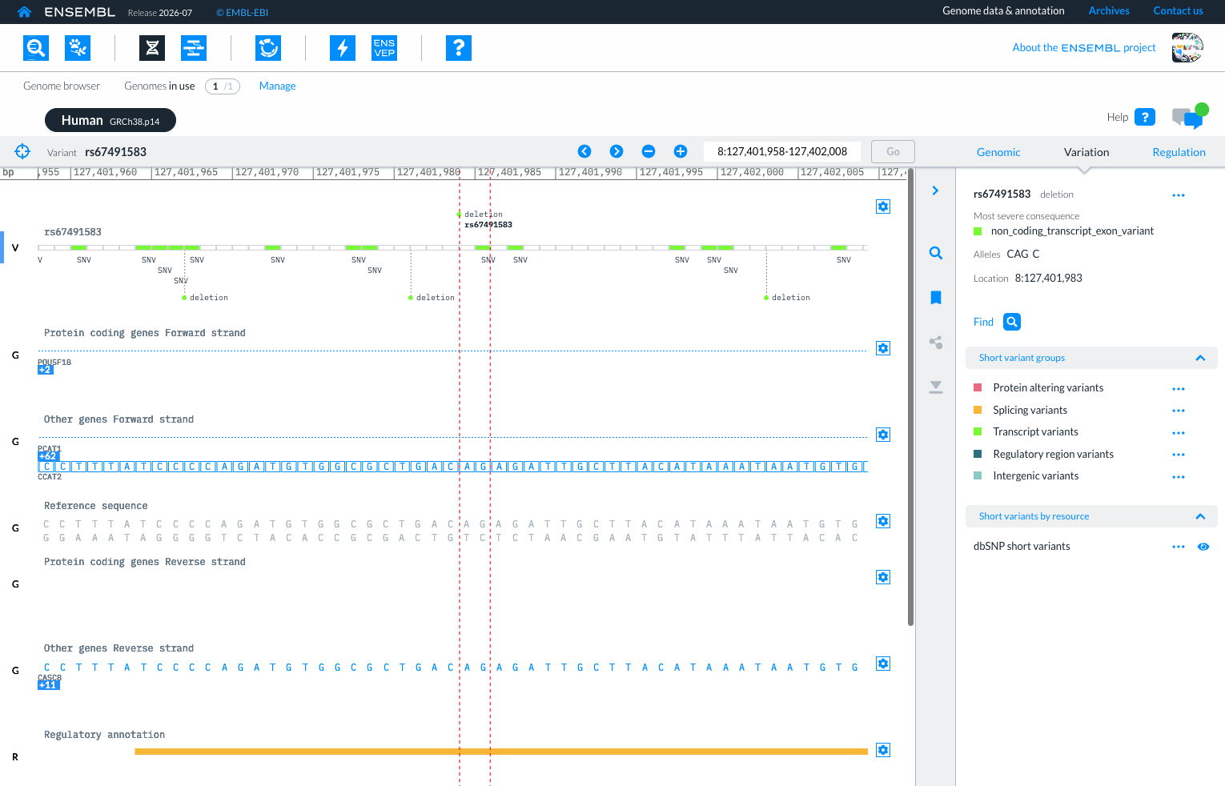
Case study 1: Human disease locus MYC / 8q24

Slide 11
Case study 1: Human disease locus MYC / 8q24
Main question: Do these 8q24 non-coding variants overlap regulatory elements that could plausibly influence MYC in a colorectal-relevant context?
Guiding questions:
How far are the variants from the MYC gene? Could it be possible that these variants belong to a regulatory region?
Do the CREs containing rs6983267 and rs67491583 show tissue- or context-specific enhancer activity?
HCT116 and Caco-2 are colorectal cancer cell lines. Are they included in the studied resources? If yes, which epigenomic evidence is available for each of them?
How is the regulatory activity in the locus for HCT116 and Caco-2?
Do the CREs annotation resources show agreement in the studied locus?

Slide 12
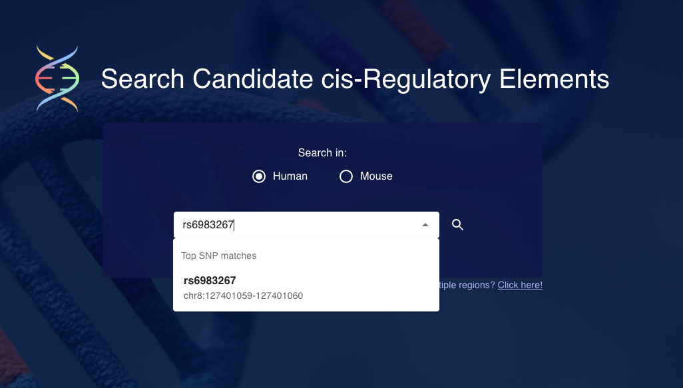
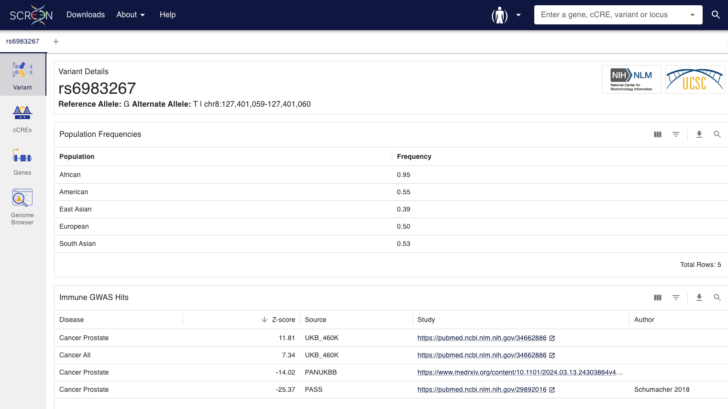
Case study 1: Using ENCODE resources
How far are the variants from the MYC gene? Could it be possible that this variants belong to a regulatory region?

Slide 13
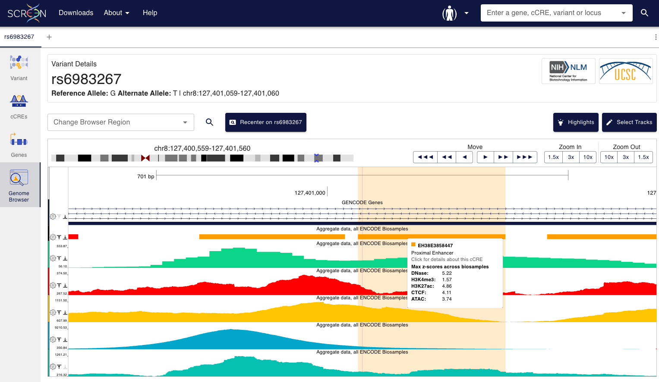
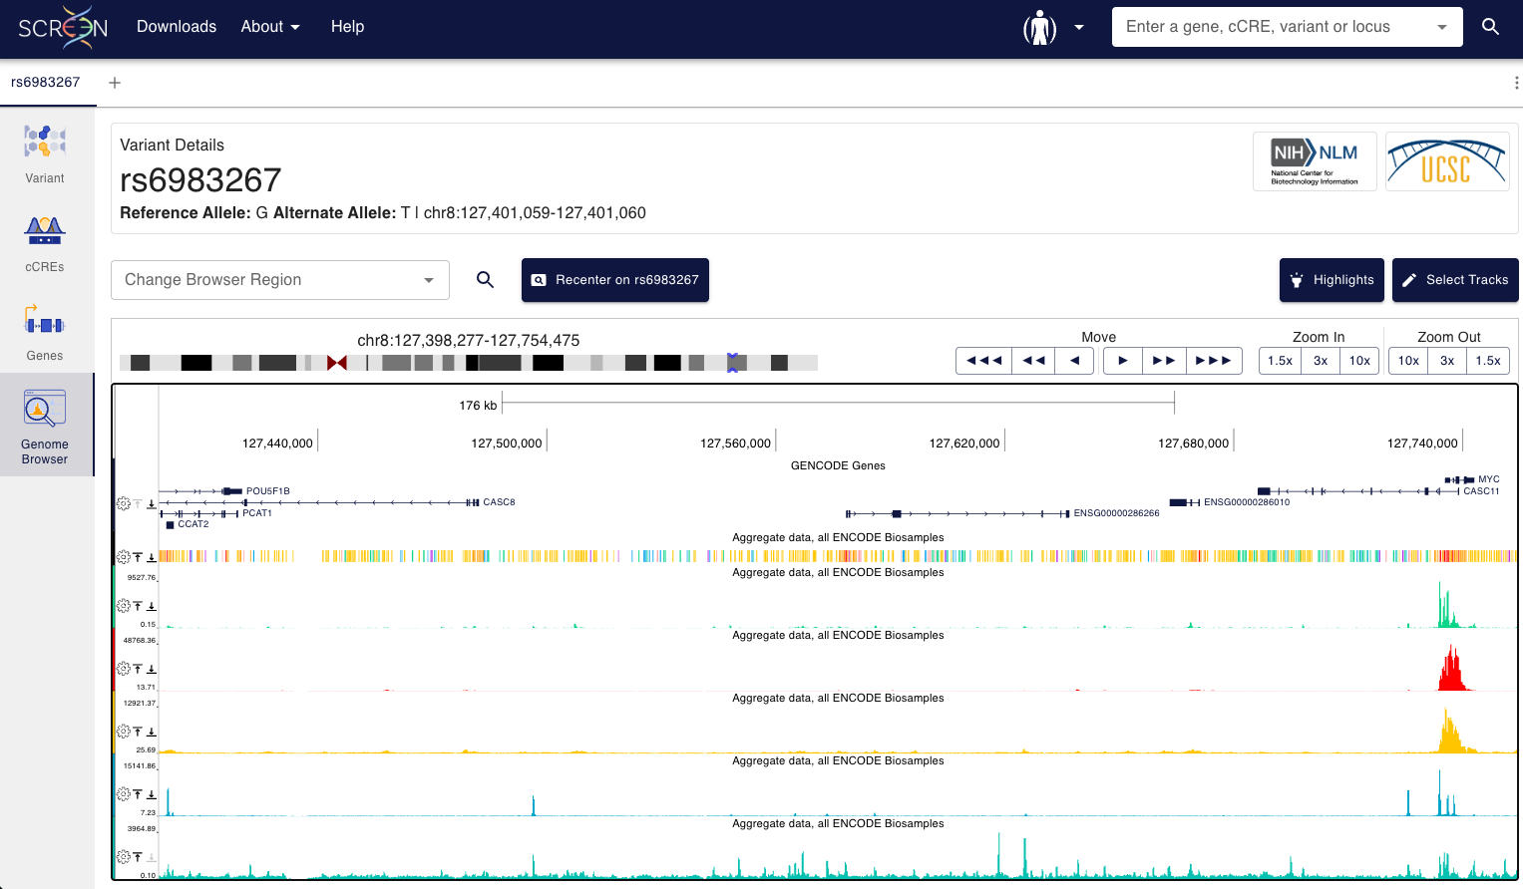
Case study 1: Using ENCODE resources
How far are the variants from the MYC gene? Could it be possible that these variants belong to a regulatory region?
The variant rs6983267 is ~334.3 kb upstream (5′) of the MYC gene
The variant rs6983267 overlaps the Proximal enhancer EH38E3858447

Slide 14
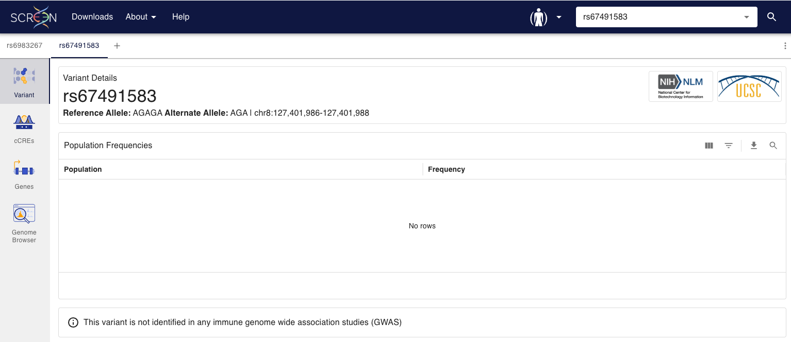
Case study 1: Using ENCODE resources
How far are the variants from the MYC gene? Could it be possible that this variants belong to a regulatory region?

Slide 15
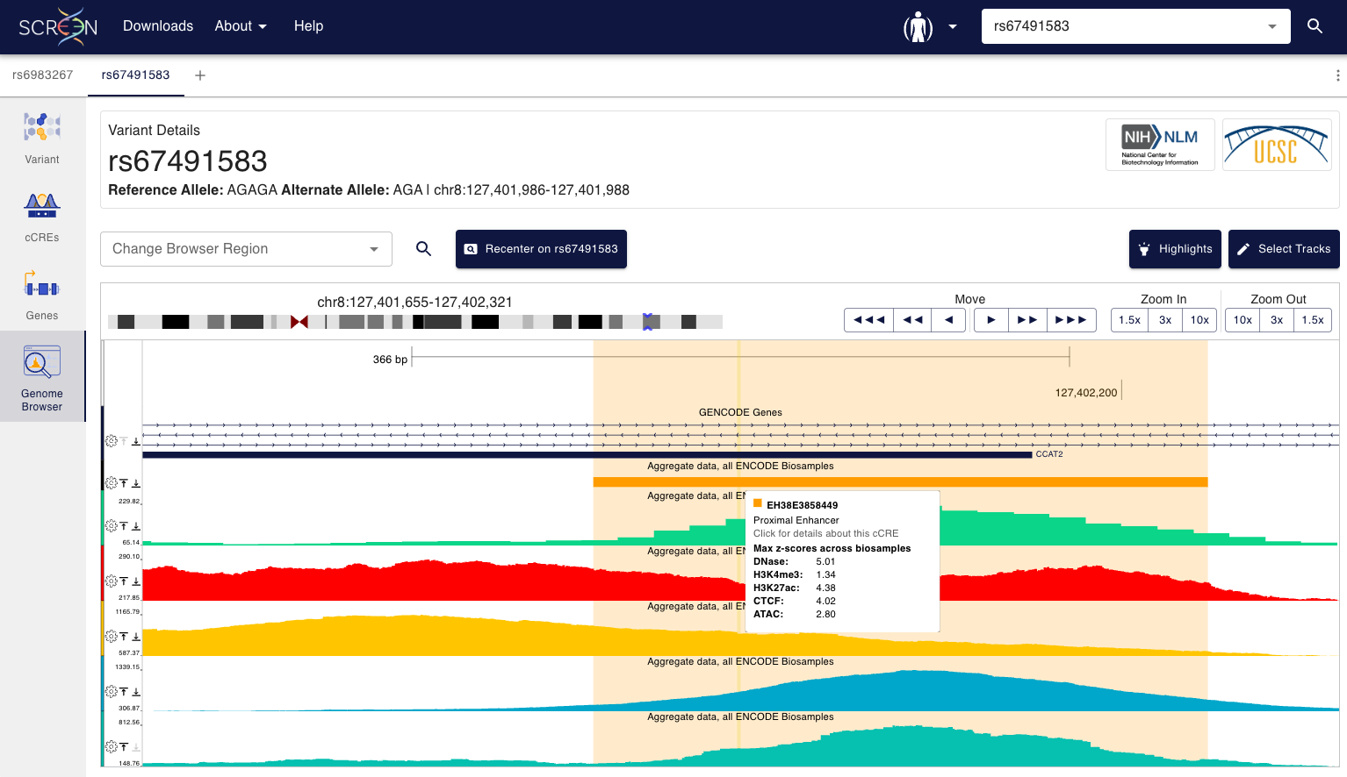
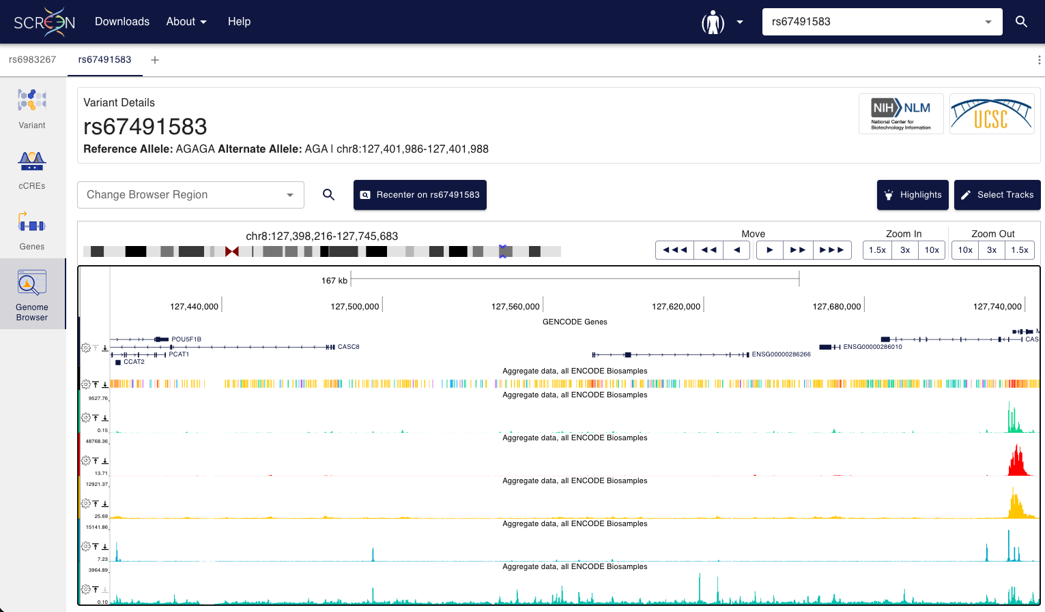
Case study 1: Using ENCODE resources
How far are the variants from the MYC gene? Could it be possible that these variants belong to a regulatory region?
The variant rs67491583 is ~333.4 kb upstream (5′) of the MYC gene
The variant rs67491583 overlaps the Proximal enhancer EH38E3858449

Slide 16
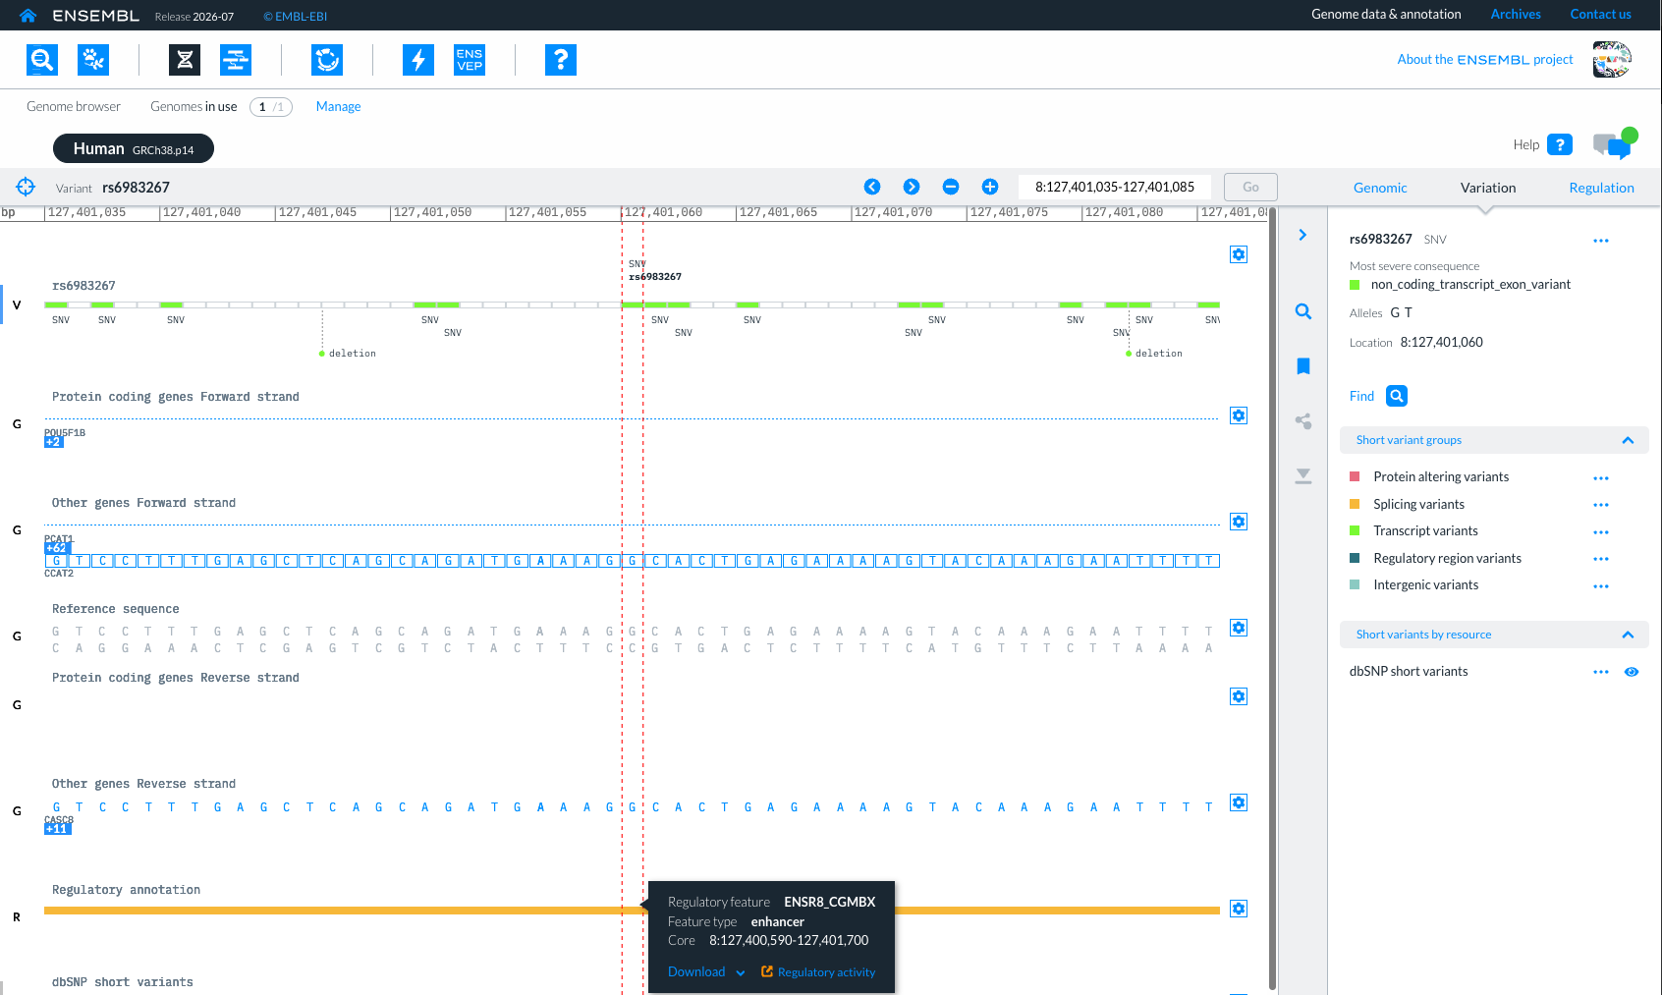
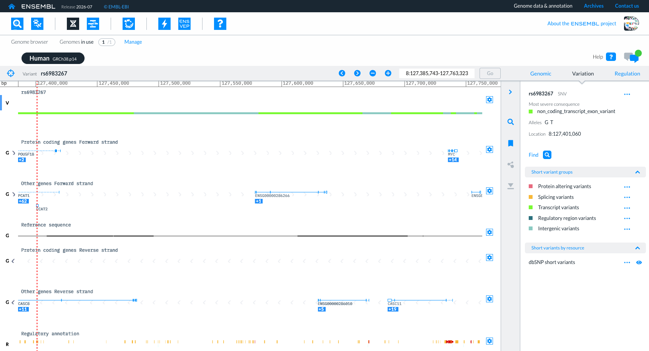
Case study 1: Using Ensembl resources
How far are the variants from the MYC gene? Could it be possible that these variants belong to a regulatory region?
The variant rs6983267 is ~334.3 kb upstream (5′) of the MYC gene
The variant rs6983267 overlaps the enhancer ENSR8_CGMBX

Slide 17
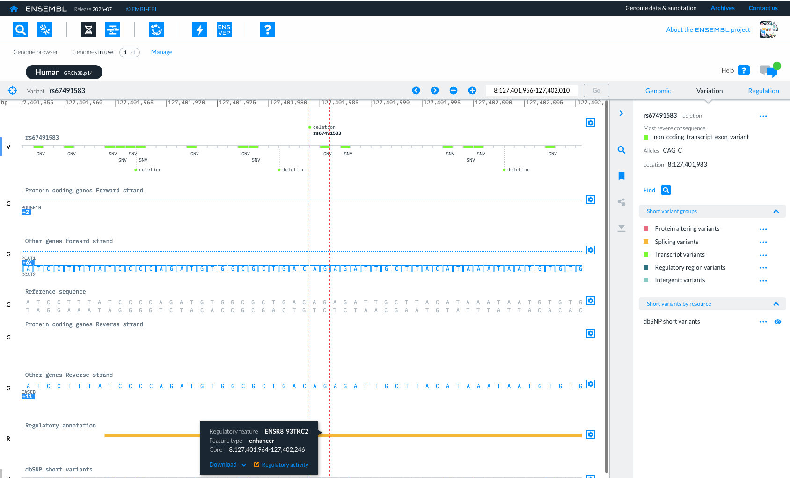
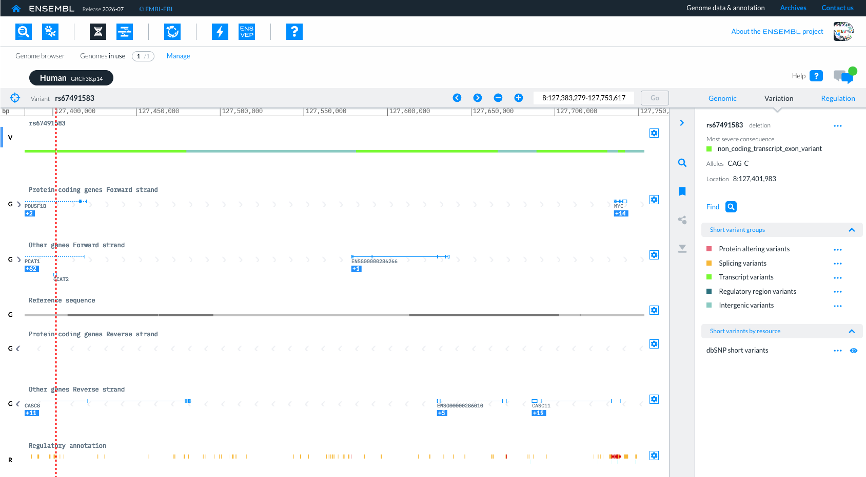
Case study 1: Using Ensembl resources
How far are the variants from the MYC gene? Could it be possible that these variants belong to a regulatory region?
The variant rs67491583 is ~333.4 kb upstream (5′) of the MYC gene
The variant rs67491583 overlaps the enhancer ENSR8_93TKC2

Slide 18
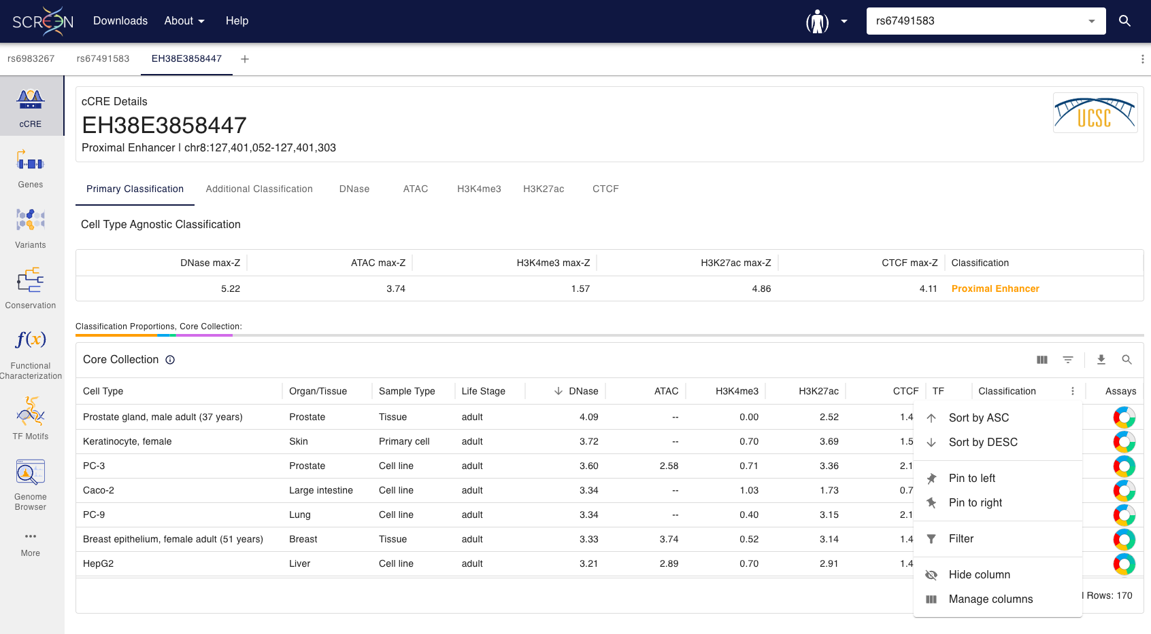
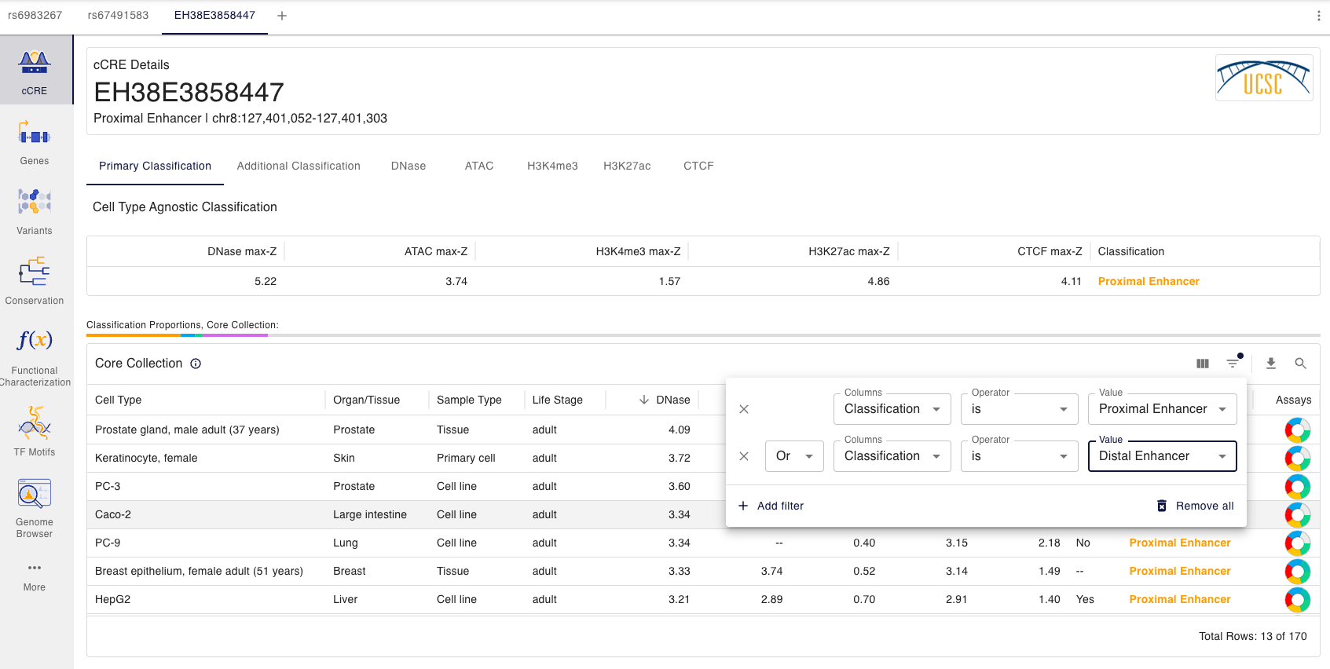
Case study 1: Using ENCODE resources
Do the CREs containing rs6983267 and rs67491583 show tissue- or context-specific enhancer activity?
The EH38E3858447 is classified as an enhancer in 13/170 core collections

Slide 19
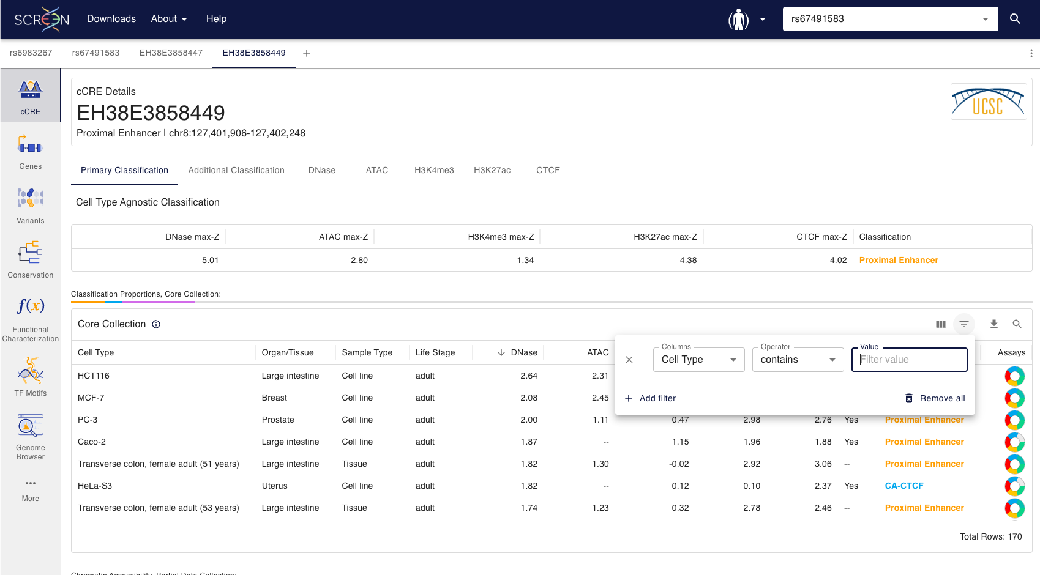
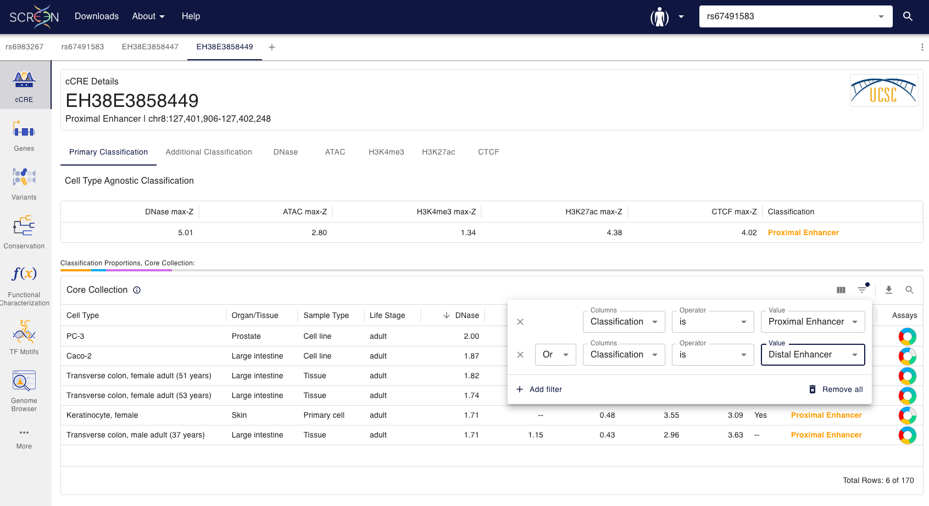
Case study 1: Using ENCODE resources
Do the CREs containing rs6983267 and rs67491583 show tissue- or context-specific enhancer activity?
The EH38E3858449 is classified as an enhancer in 6/170 core collections

Slide 20
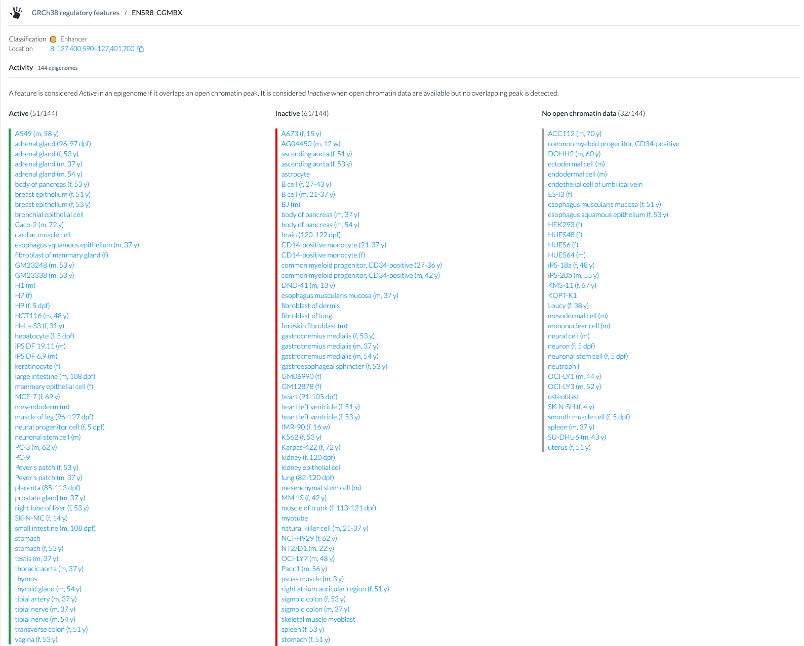
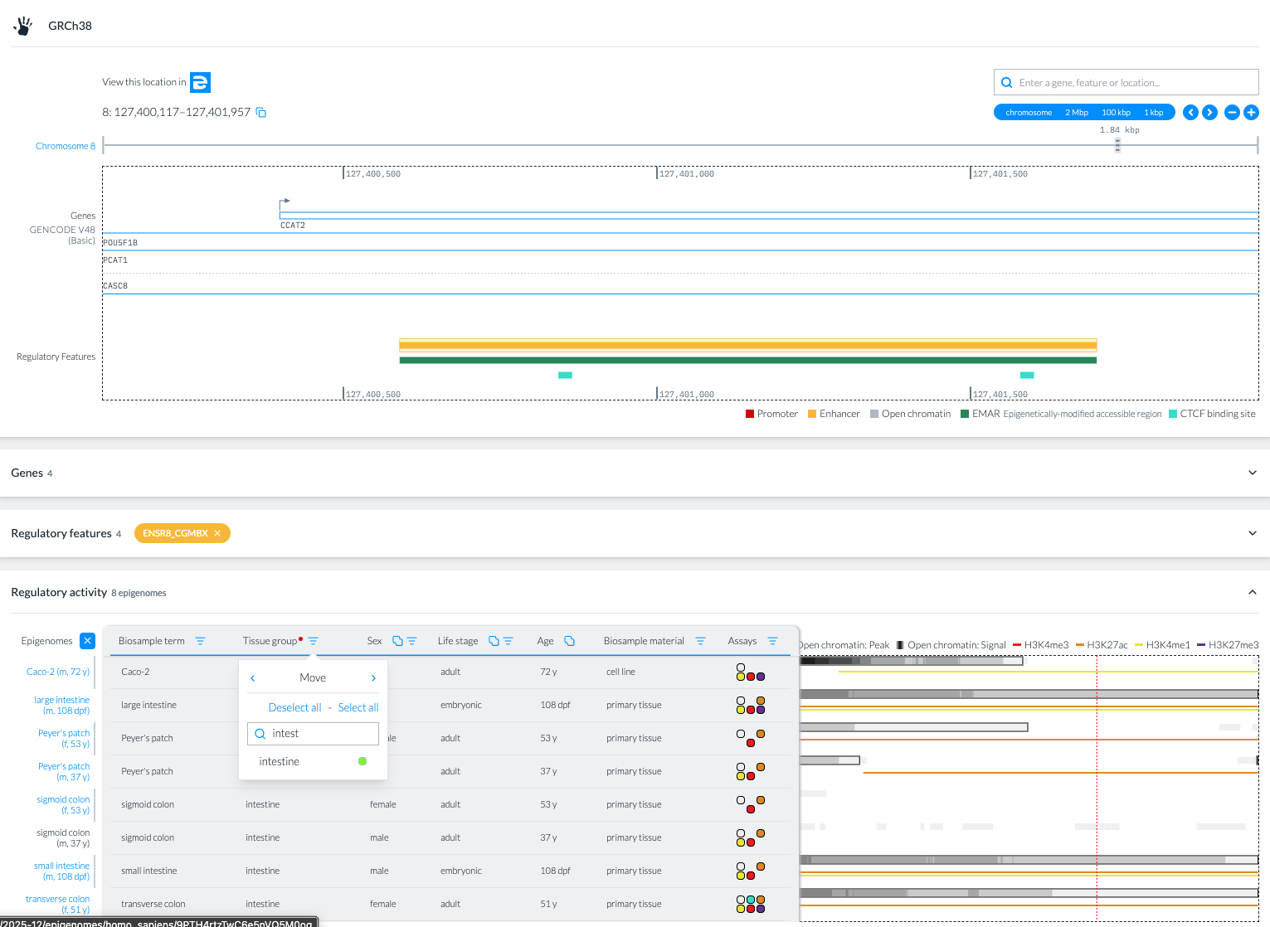
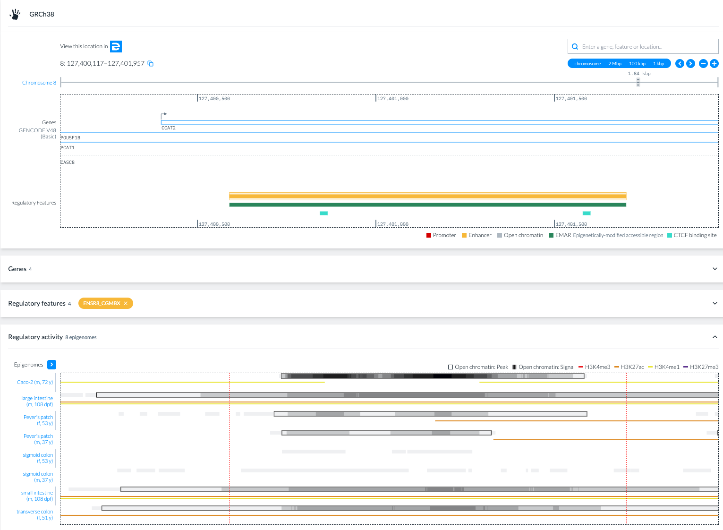
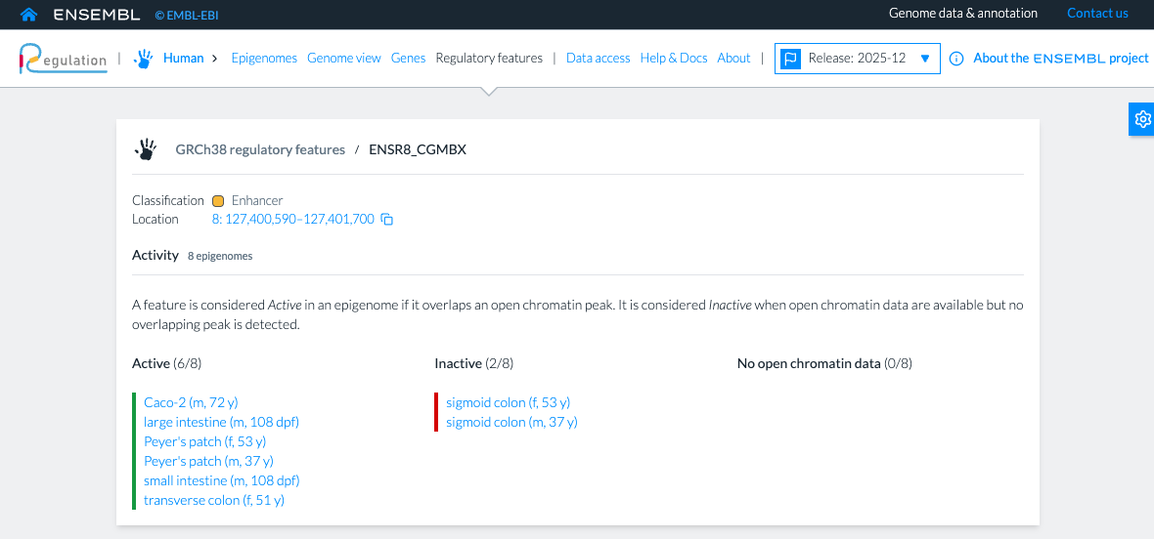
Case study 1: Using Ensembl resources
Do the CREs containing rs6983267 and rs67491583 show tissue- or context-specific enhancer activity?
The ENSR8_CGMBX is classified as an active enhancer in 51/144 epigenomes
The ENSR8_CGMBX is classified as an active enhancer in 6/8 intestine epigenomes

Slide 21
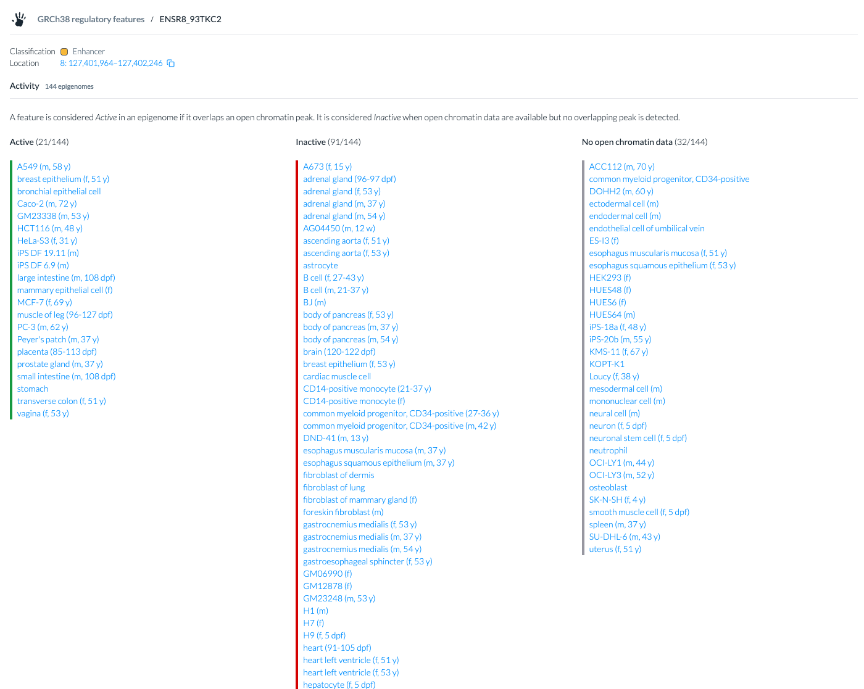
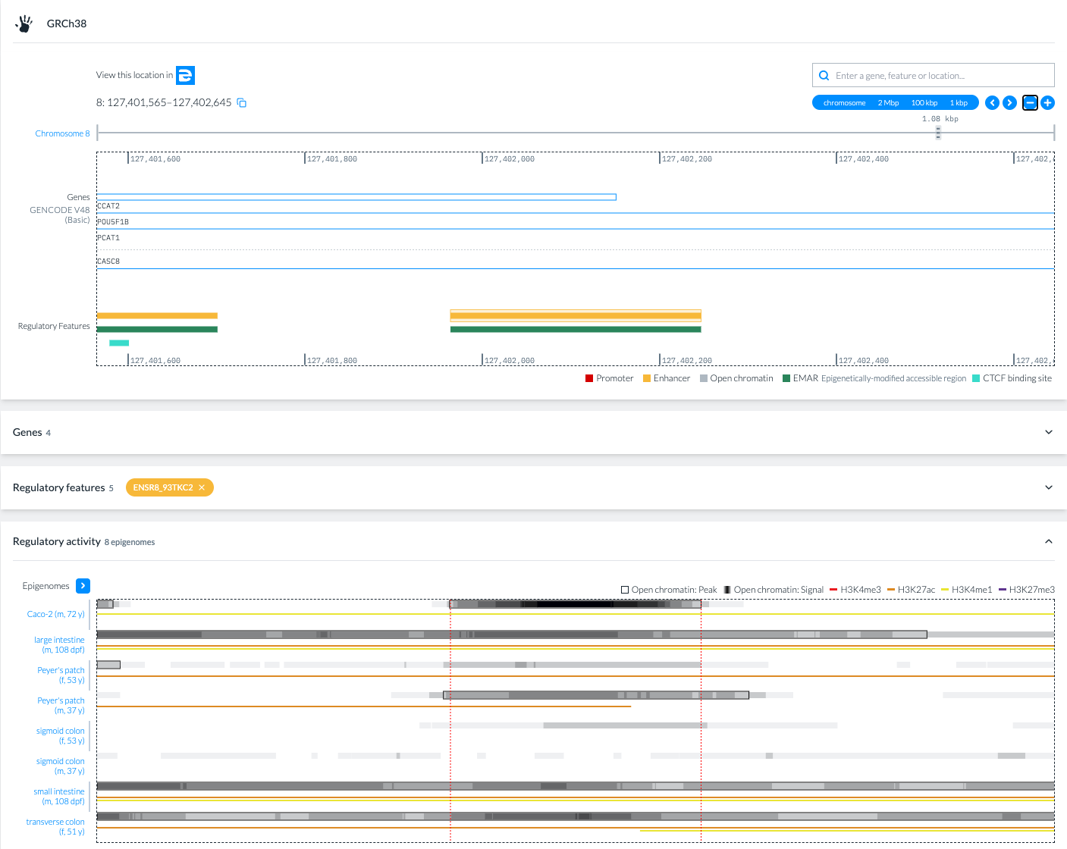
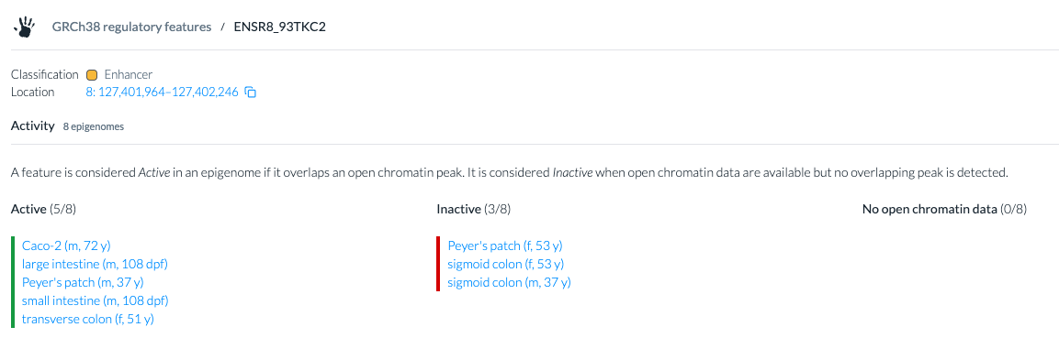
Case study 1: Using Ensembl resources
Do the CREs containing rs6983267 and rs67491583 show tissue- or context-specific enhancer activity?
The ENSR8_93TKC2 is classified as an active enhancer in 21/144 epigenomes
The ENSR8_93TKC2 is classified as an active enhancer in 5/8 intestine epigenomes

Slide 22
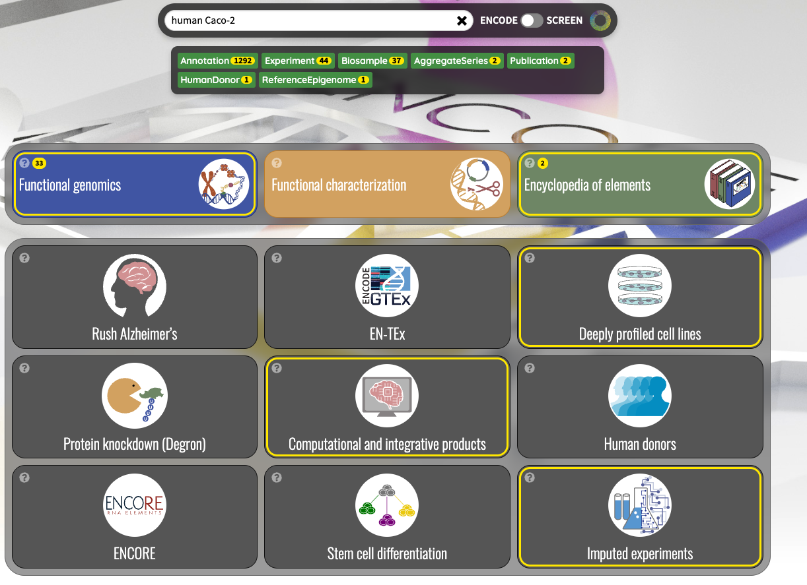
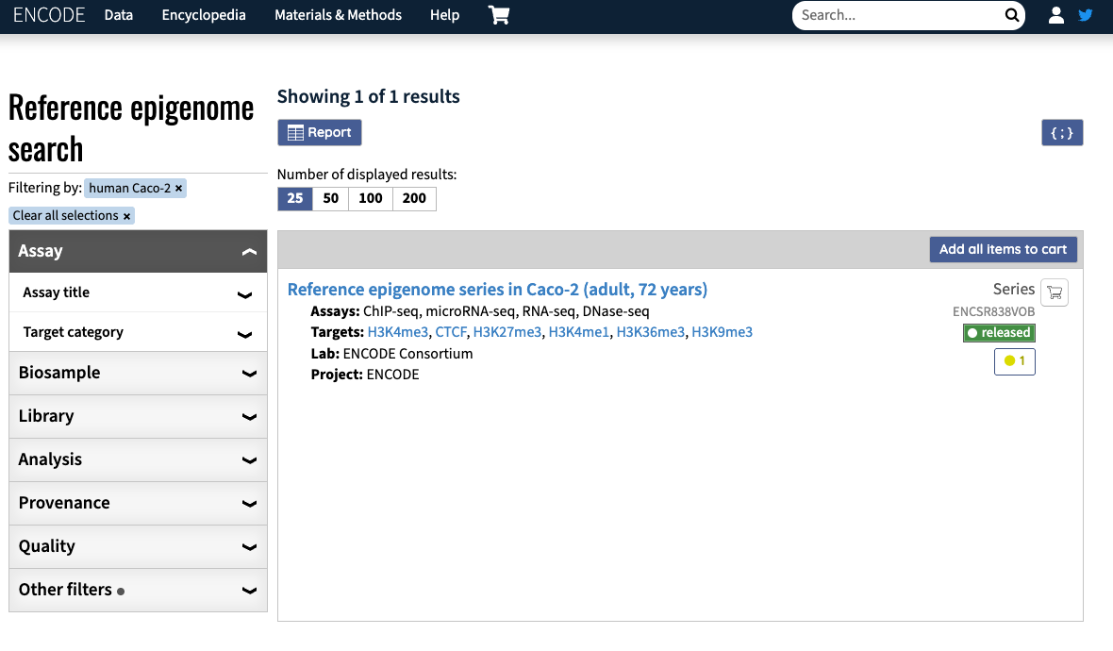
Case study 1: Using ENCODE resources
HCT116 and Caco-2 are colorectal cancer cell lines. Are they included in the studied resources? If yes, which epigenomic evidence is available for each of them?

Slide 23
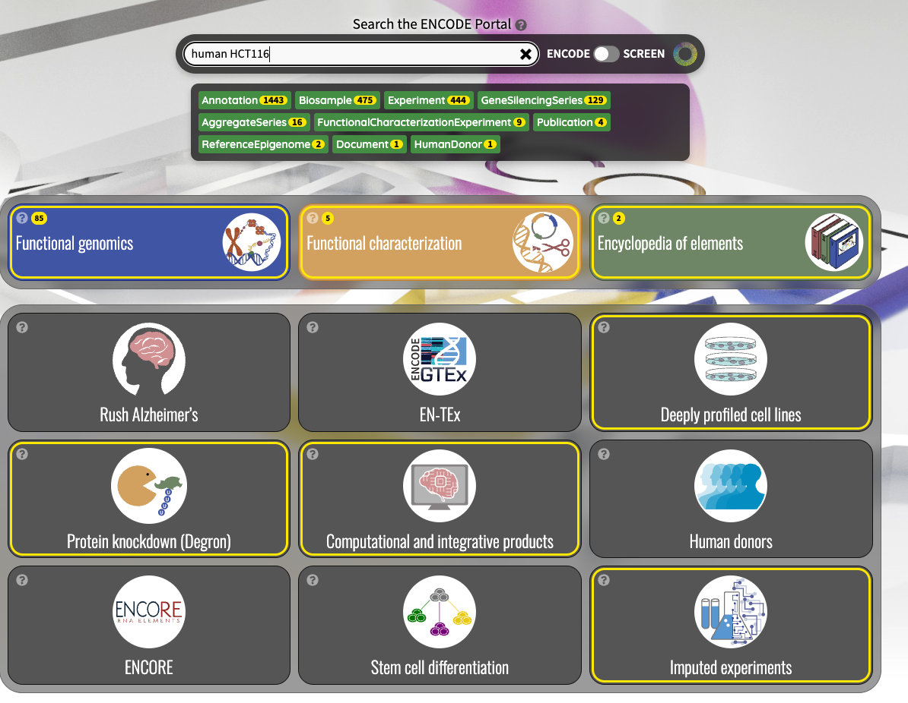
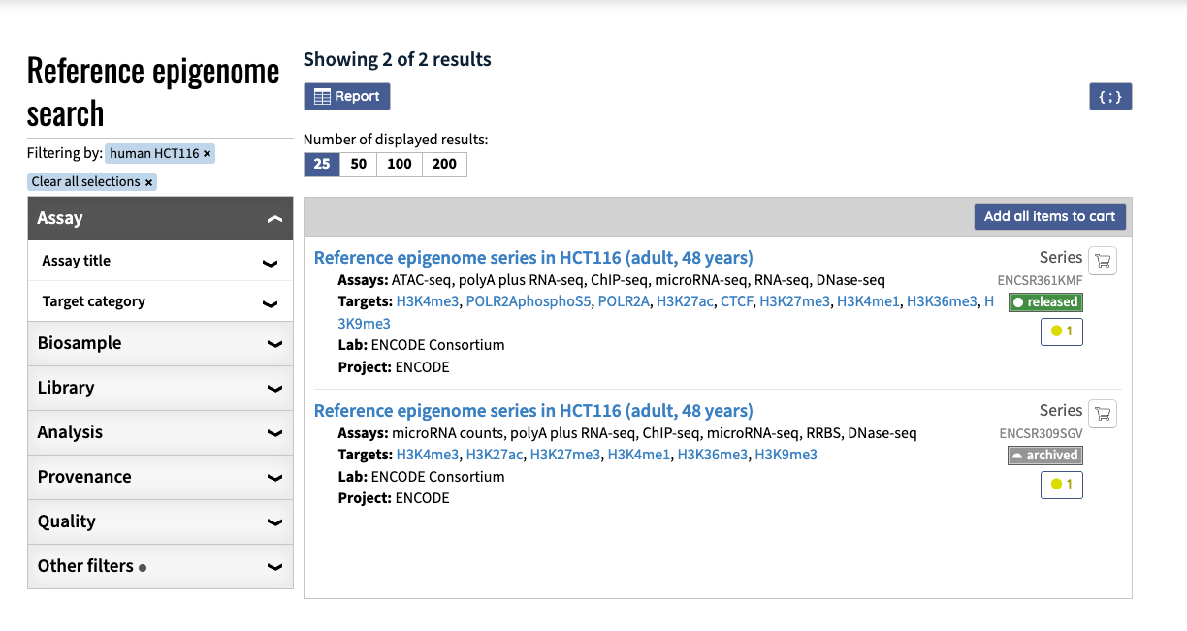
Case study 1: Using ENCODE resources
HCT116 and Caco-2 are colorectal cancer cell lines. Are they included in the studied resources? If yes, which epigenomic evidence is available for each of them?

Slide 24
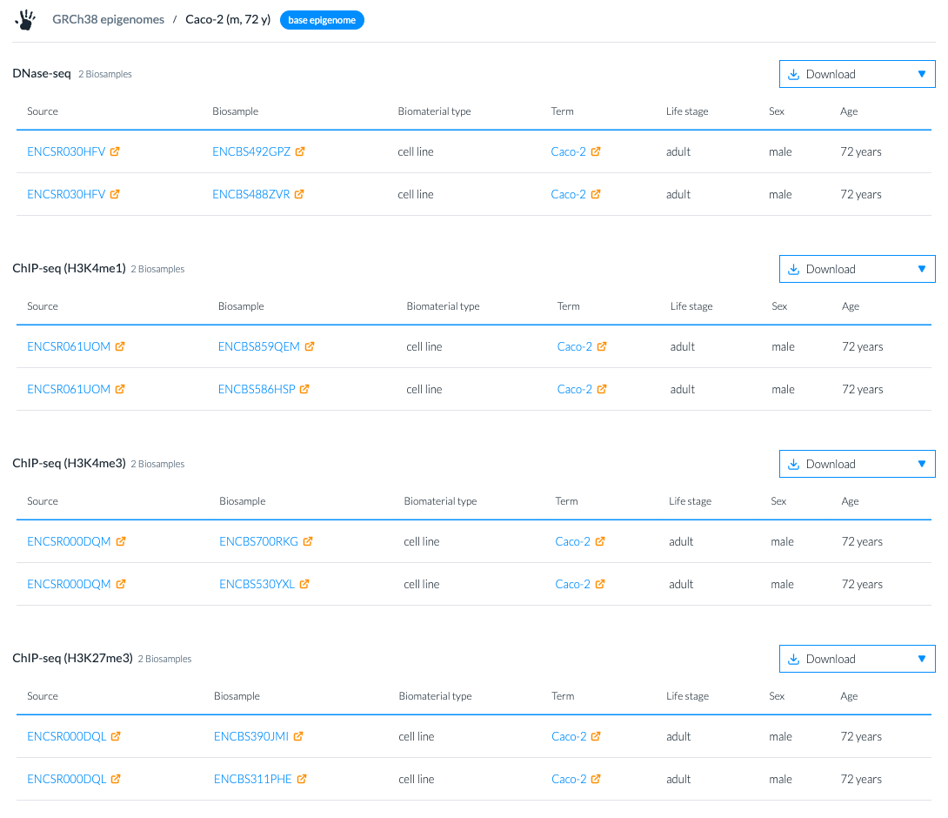
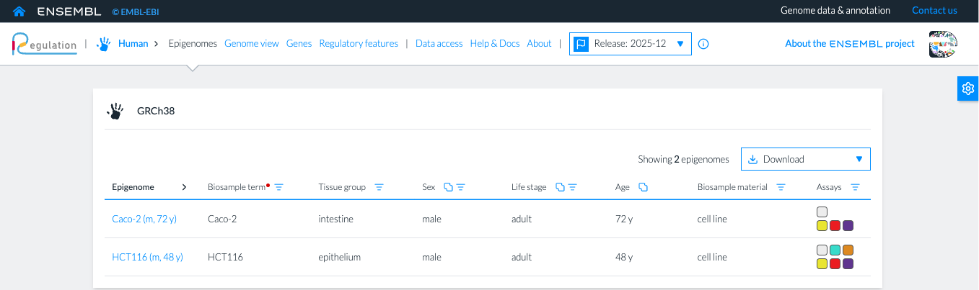
Case study 1: Using Ensembl resources
HCT116 and Caco-2 are colorectal cancer cell lines. Are they included in the studied resources? If yes, which epigenomic evidence is available for each of them?

Slide 25
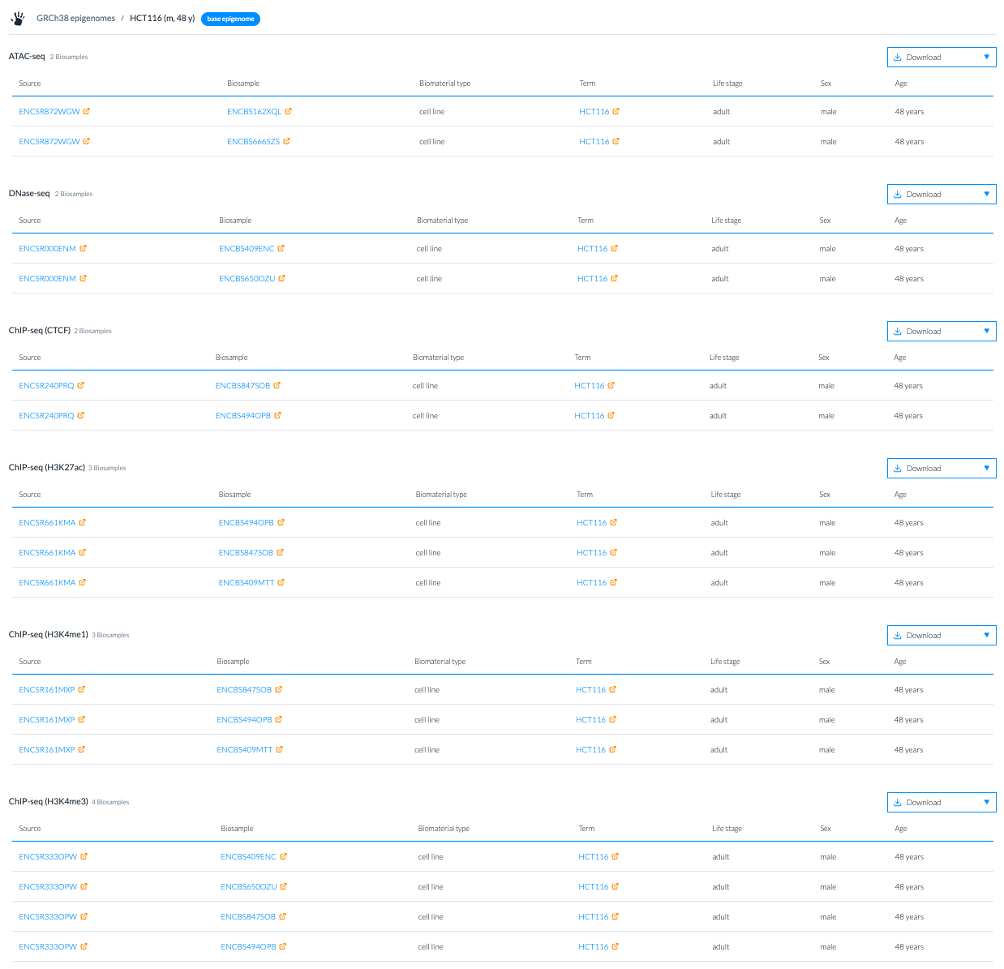
Case study 1: Using Ensembl resources
HCT116 and Caco-2 are colorectal cancer cell lines. Are they included in the studied resources? If yes, which epigenomic evidence is available for each of them?

Slide 26
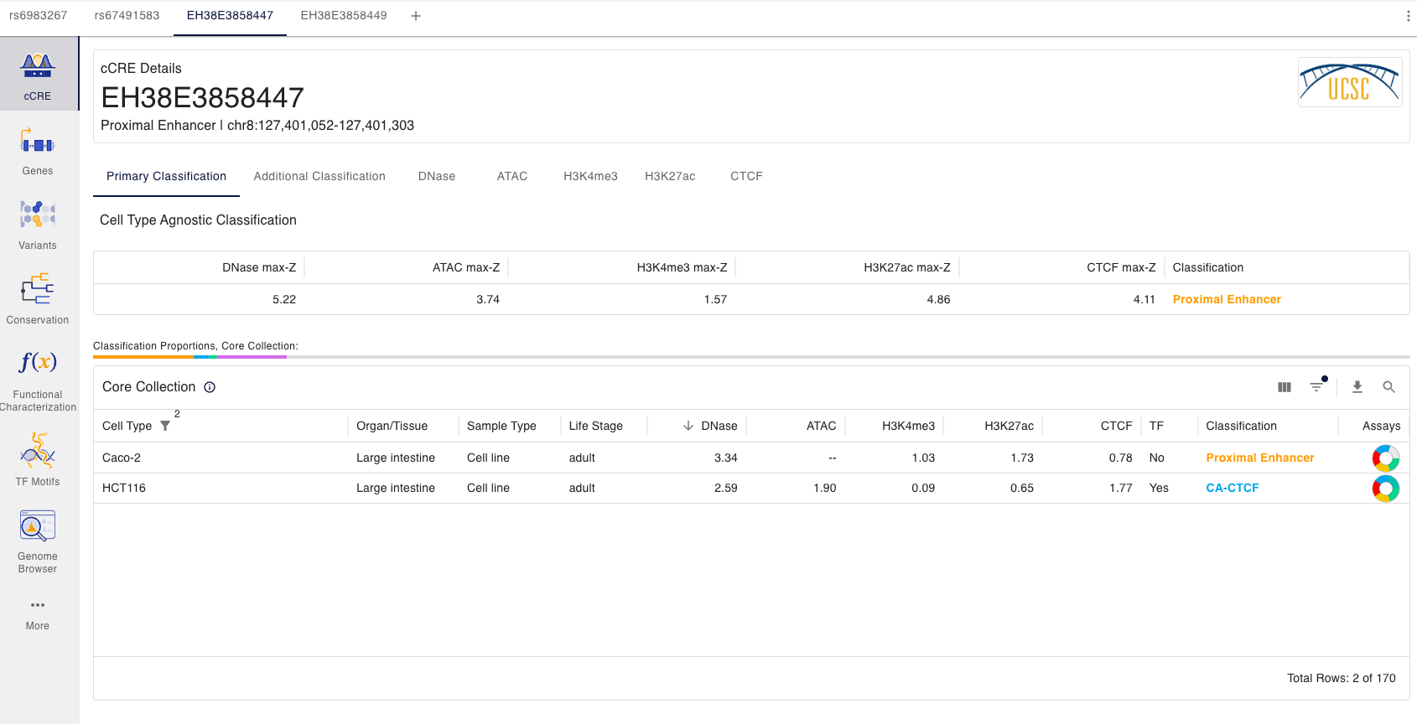
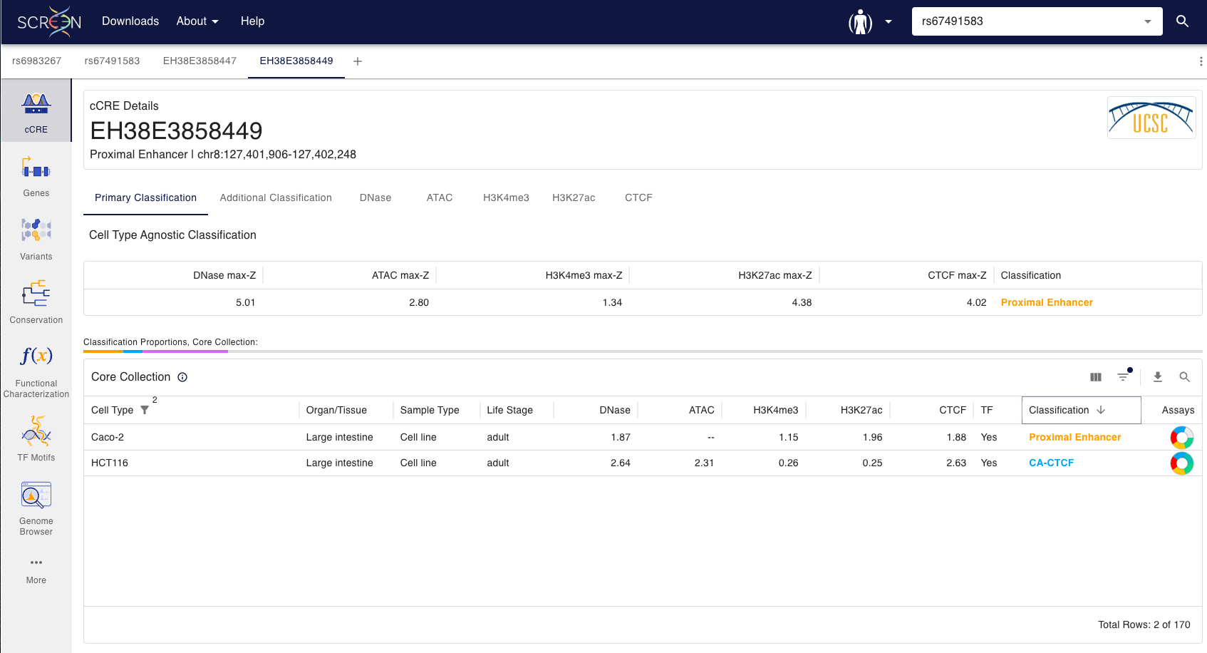
Case study 1: Using ENCODE resources
How is the regulatory activity in the locus for HCT116 and Caco-2?
The EH38E3858447 and EH38E3858449 are both classified as Proximal enhancer in Caco-2 and as CA-CTCF in HCT116.

Slide 27
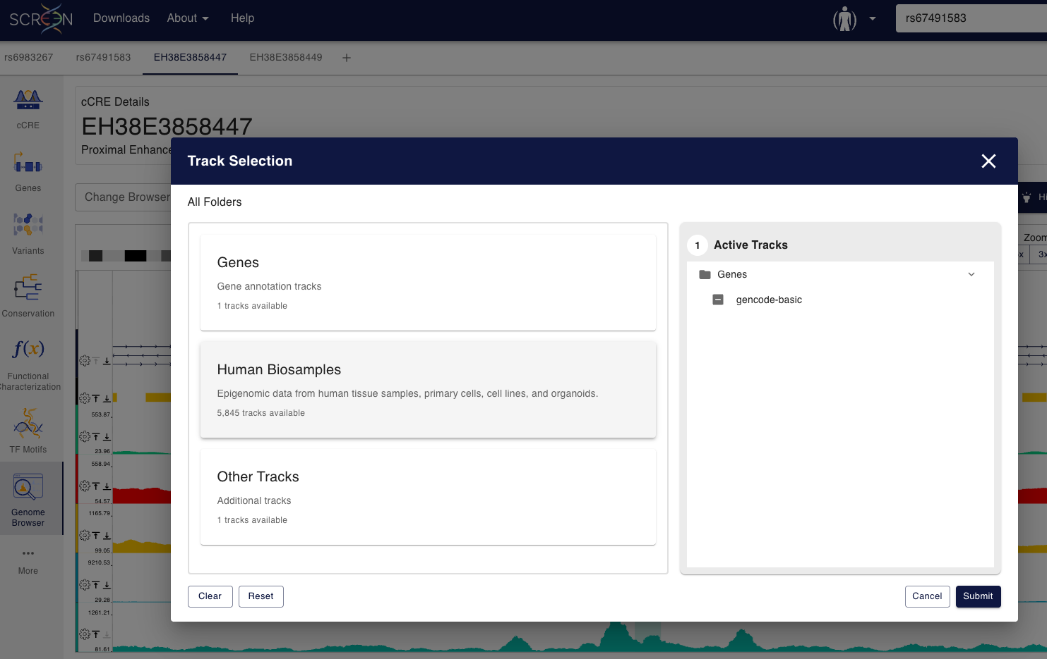
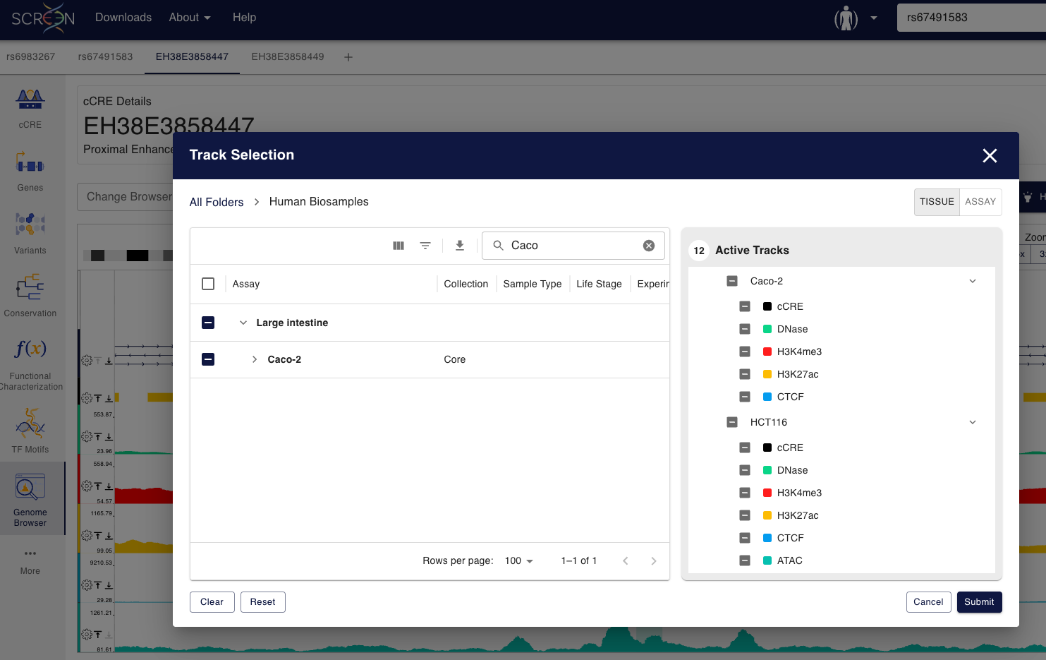
Case study 1: Using ENCODE resources
How is the regulatory activity in the locus for HCT116 and Caco-2?
Select epigenomic tracks from HCT116 and Caco-2

Slide 28
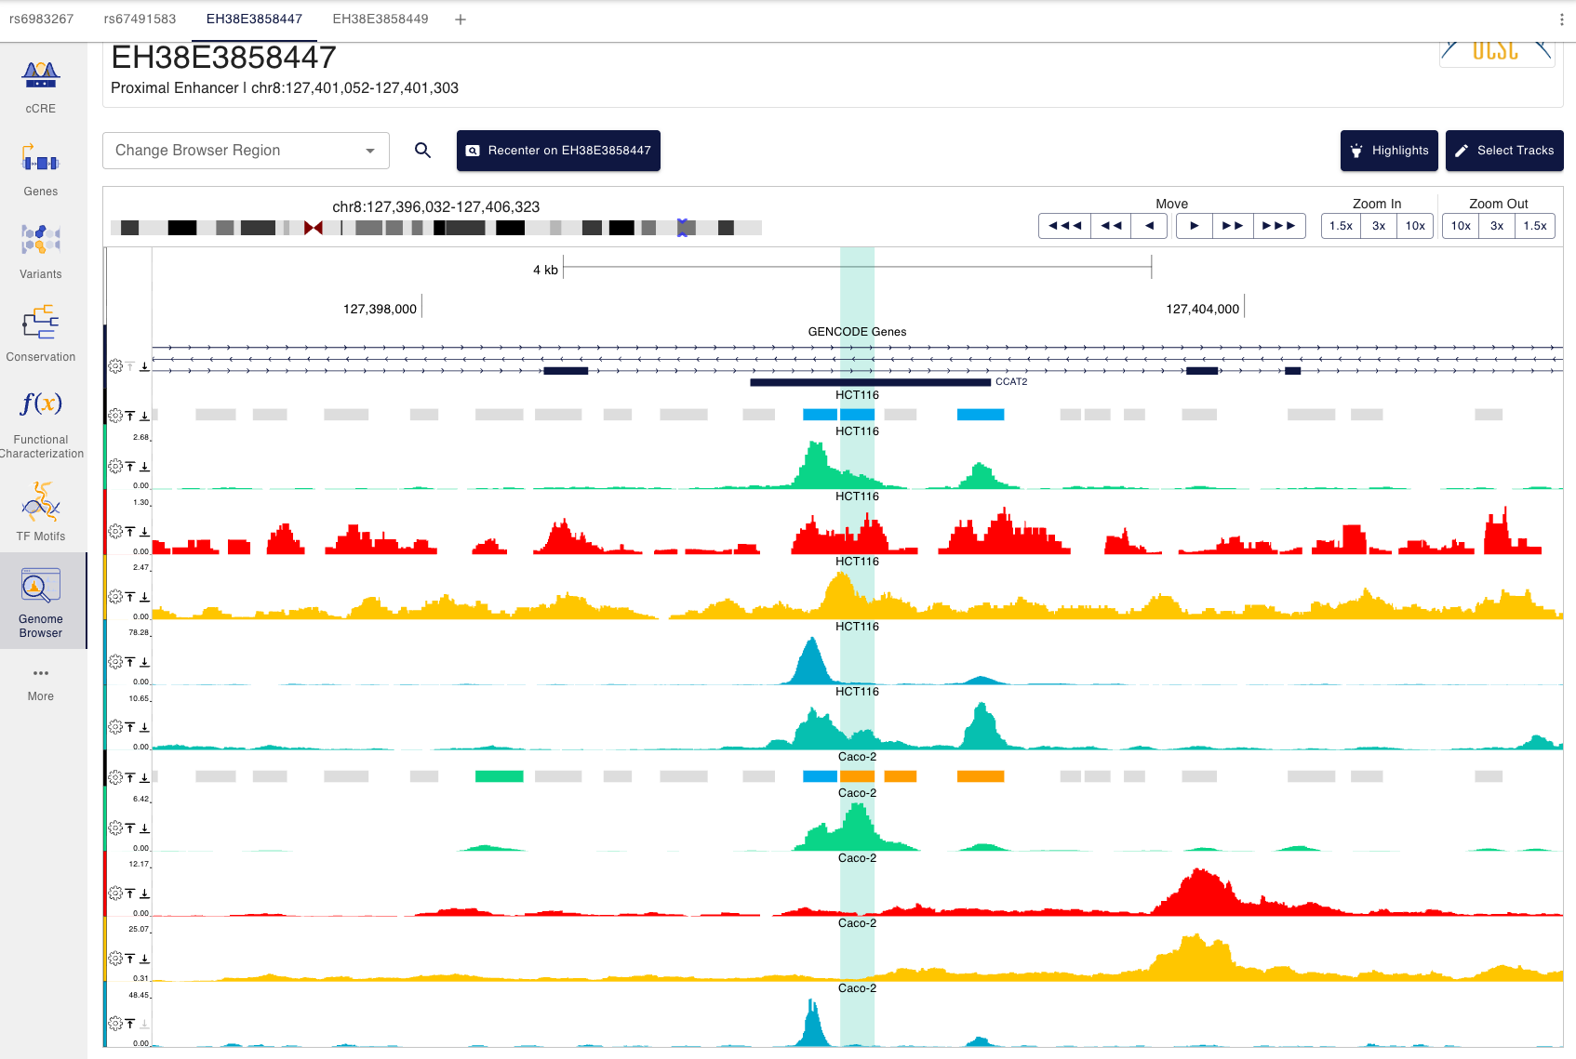
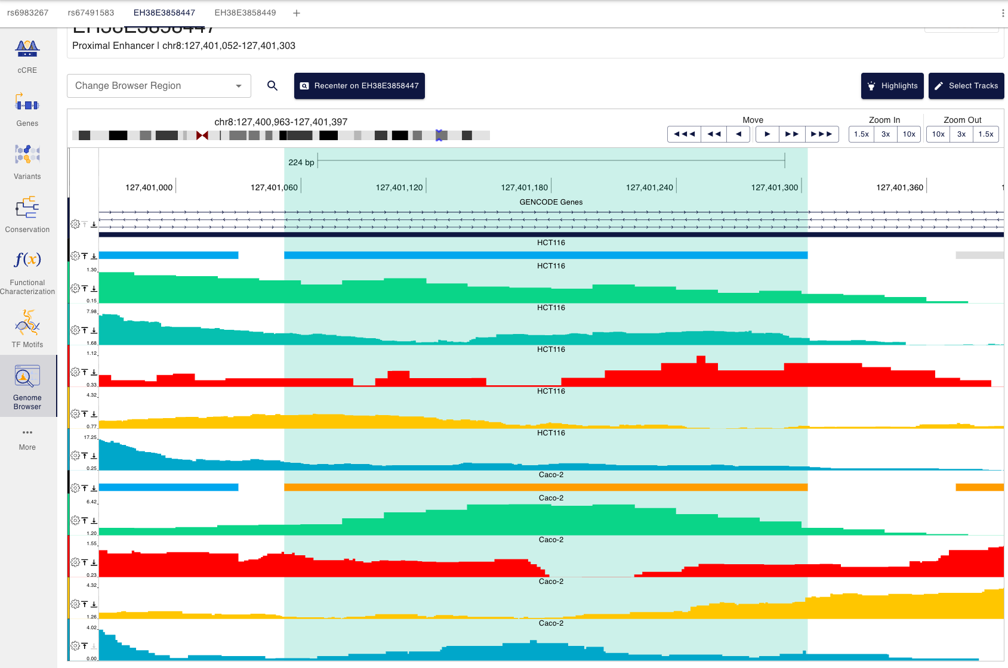
Case study 1: Using ENCODE resources
How is the regulatory activity in the locus for HCT116 and Caco-2?
For EH38E3858447, the H3K27ac signal for HCT116 and Caco-2 doesn’t show big differences. CTCF signal is high in both cell types.

Slide 29


Case study 1: Using ENCODE resources
How is the regulatory activity in the locus for HCT116 and Caco-2?
For EH38E3858449, the H3K27ac signal for HCT116 is ~3 times lower than for Caco-2 although it doesn’t show a clear peak. CTCF signal is high in both cell types.

Slide 30

Case study 1: Using Ensembl resources
How is the regulatory activity in the locus for HCT116 and Caco-2?
Select HCT116 and Caco-2 on the epigenomes table

Slide 31

Case study 1: Using Ensembl resources
How is the regulatory activity in the locus for HCT116 and Caco-2?

Slide 32

Case study 1: Using ENCODE resources
How is the regulatory activity in the locus for HCT116 and Caco-2?
For both, ENSR8_CGMBX and ENSR8_93TKC2, HCT116 and Caco-2 show evidence of open chromatin and H3K4me1 signal. For ENSR8_CGMBX, HCT116 also shows evidence of H3K27ac signal.

Slide 33

Case study 1
Do the CREs annotation resources show agreement in the studied locus?
rs6983267 overlaps with EH38E3858447, classified by ENCODE as Proximal enhancer in Caco-2 and as CA-CTCF in HCT116, and with ENSR8_CGMBX, classified by Ensembl regulation as Active enhancer in both cell lines.
rs67491583 overlaps with EH38E3858449, classified by ENCODE as Proximal enhancer in Caco-2 and as CA-CTCF in HCT11, and with ENSR8_93TKC2, classified by Ensembl Regulation as Active enhancer in both cell lines.

Slide 34
Case study 1: Using ENCODE resources
Main question: Do these 8q24 non-coding variants overlap regulatory elements that could plausibly influence MYC in a colorectal-relevant context?
Yes, the non-coding variants overlap enhancer CREs that could play a role in regulating MYC through long range interactions. According to both ENCODE Screen and Ensembl Regulation, the regulatory elements containing the non-coding variants show activity in the explored colorectal-cancer cell lines. Ensembl Regulation classified the two regulatory elements as Active Enhancers in both cell lines while ENCODE classified them as Distal Enhancers only in Caco-2.

Slide 35
Case study 2: Mouse Dlx5/Dlx6 and the I56i enhancer
The Dlx5/Dlx6 intergenic region contains the conserved enhancer I56i (GRCm39/mm10, chr6:6,869,098-6,869,533), which has been described as a forebrain enhancer active in GABAergic interneuron development ⁴.
chr6:6,869,492 A>G in I56i was reported to impair enhancer activity in the developing forebrain and adult cortex ⁴.
The location of the SNP coincides with one of the two putative Dlx binding sites within I56i. This region of I56i also encodes the second exon of the long polyadenylated non-coding RNA (lpncRNA) Evf2 (Dlx6os1).
⁴Poitras, Luc, et al. "An SNP in an ultraconserved regulatory element affects Dlx5/Dlx6 regulation in the forebrain." Development 137.18 (2010): 3089-3097.

Slide 36
Case study 2: Mouse Dlx5/Dlx6 and the I56i enhancer
Main question: Does the I56i candidate sequence correspond to a current regulatory annotation near Dlx5/Dlx6? How strong is the evidence that it acts as a forebrain enhancer?
Guiding questions:
Are there regulatory elements in the Dlx5/Dlx6 locus?
Is the region strongly regulated in forebrain developmental stages?
Do the epigenomic evidence tracks support the I56i enhancer region?
Do the CREs annotation resources show agreement in the studied locus?

Slide 37




Case study 2: Dlx5/Dlx6 and the I56i enhancer - ENCODE
The Dlx5/Dlx6 intergenic region

Slide 38

Case study 2: Dlx5/Dlx6 and the I56i enhancer - ENCODE
The Dlx5/Dlx6 intergenic region

Slide 39

Case study 2: Dlx5/Dlx6 and the I56i enhancer - Ensembl
The Dlx5/Dlx6 intergenic region

Slide 40


Case study 2: Dlx5/Dlx6 and the I56i enhancer - Ensembl
The Dlx5/Dlx6 intergenic region

Slide 41


Case study 2: Dlx5/Dlx6 and the I56i enhancer - Ensembl
The Dlx5/Dlx6 intergenic region

Slide 42


Case study 2: Dlx5/Dlx6 and the I56i enhancer - ENCODE
The conserved enhancer I56i (GRCm39/mm10, chr6:6,869,098-6,869,533)
The i561 enhancer covers a region that contains a Distal enhancer, EM10E0813270, and a Proximal enhancer, EM10E0813271.

Slide 43


Case study 2: Dlx5/Dlx6 and the I56i enhancer - Ensembl
The conserved enhancer I56i (GRCm39/mm10, chr6:6,869,098-6,869,533)
The i561 enhancer covers a region that contains an enhancer, ENSMUSR6_B3CRS, and a small section of a promoter, ENSMUSR6_94PLR.

Slide 44


Case study 2: Dlx5/Dlx6 and the I56i enhancer - ENCODE
chr6:6,869,492 A>G in I56i was reported to impair enhancer activity in the developing forebrain and adult cortex
The I56i variant overlaps the Proximal enhancer, EM10E0813271.

Slide 45


Case study 2: Dlx5/Dlx6 and the I56i enhancer - ENCODE
chr6:6,869,492 A>G in I56i was reported to impair enhancer activity in the developing forebrain and adult cortex
The Proximal enhancer EM10E0813271 is annotated as such only in two datasets that come from forebrain biosamples.

Slide 46

Case study 2: Dlx5/Dlx6 and the I56i enhancer - ENCODE
Forebrain epigenomes with DNase data are part of the core and partial data collections.
Forebrain epigenomes in ancillary collection do not have DNase, they have ATAC data but that is not used for CREs definition

Slide 47

Case study 2: Dlx5/Dlx6 and the I56i enhancer - ENCODE
There is a good support on open-chromatin and H3K27ac signals for the forebrain epigenomes on the EM10E0813271 enhancer, although it is stronger for EM10E0813270

Slide 48

Case study 2: Dlx5/Dlx6 and the I56i enhancer - Ensembl
chr6:6,869,492 A>G in I56i was reported to impair enhancer activity in the developing forebrain and adult cortex
The I56i variant overlaps the enhancer, ENSMUSR6_B3CRS.

Slide 49

Case study 2: Dlx5/Dlx6 and the I56i enhancer - Ensembl
chr6:6,869,492 A>G in I56i was reported to impair enhancer activity in the developing forebrain and adult cortex
The I56i variant overlaps the enhancer, ENSMUSR6_B3CRS. ENSMUSR6_B3CRS is reported as Active in different developmental stages (from E13.5 to newborn) of forebrain epigenomes.

Slide 50

Case study 2: Dlx5/Dlx6 and the I56i enhancer - Ensembl
chr6:6,869,492 A>G in I56i was reported to impair enhancer activity in the developing forebrain and adult cortex
In forebrain epigenomes, the enhancer activity becomes more evident from developmental stage E13.5 to newborn.

Slide 51
Case study 2: Dlx5/Dlx6 and the I56i enhancer - Ensembl
Do the CREs annotation resources show agreement in the studied locus?
Both resources report an enhancer overlapping the variant and the I56i enhancer. The evidence supporting regulatory activity of these elements in forebrain epigenomes is stronger in Ensembl Regulation.

